Slide 1
B R O O K L Y N B O U L D E R S

Slide 2
BE
YOUR
HERO
CONNECTING COMMUNITY
THROUGH HEROIC
INDIVIDUALITY

Slide 3
01
CAMPAIGN STRUCTURE + STRATEGY
06
MEET OUR HEROES
02
WHO ARE THE HEROES?
07
THEIR STORIES CONTINUE
03
08
LIVE THE LIFESTYLE
BUSHWICK: THE NEW BREED
04
09
BE YOUR HERO IN ACTION
QUEENSBRIDGE: ALL-WEEK WARRIORS
05
10
CAMPAIGN ECOSYSTEM + CALENDAR
GOWANUS: THE BKB OG
Notes:
Read through ToC

Slide 4
CAMPAIGN
STRUCTURE
STRATEGY
GOAL
POSITIONING
SOLUTIONS

Slide 5
CAMPAIGN STRUCTURE
TASK 1
Establish the
Meaning of Message:
“BE YOUR HERO.”
SOLUTION 1
A content marketing ecosystem comprising the “Meet Our Heroes” video series, advertising, news stories, + social media will tell the “BKB: Be Your Hero” story.
BUSINESS GOAL
Develop and execute strategies focused on member retention and engagement for GOWANUS.
Develop and execute Strategies focused on member growth for QUEENSBRIDGE + BUSHWICK.
POSITIONING
Brooklyn Boulders
is Hero Training.
TASK 2
Add Value to “BKB: Be Your Hero” for Members:
MERCH & EVENTS.
SOLUTION 2
Heroic merchandise + events let members fully live the lifestyle we are communicating.
CAMPAIGN CONCEPT
BKB: Be Your Hero.
TASK 3
Invite Members to
Become Heroic:
INTERFACILITY COMPETITION + DIGITAL HUB.
SOLUTION 3
Establishing a yearly flagship interfacility competition will foster growth — both for
Brooklyn Boulders and its community.
Notes:
This is our campaign structure — we have our goals (member retention for gowanus + new member acquisitions for bushwick and queensbridge)
Our position: Brooklyn Boulders IS hero training.
The campaign is BKB: Be Your Hero.
And “Be Your Hero” is our message. We’re going to establish the message’s meaning via a member-focused video series, advertising, media placement, and social media.
We will show our community how we add value to our message by offering heroic merchandise and events.
This culminates with our invitation to become heroes: interfacility competition — and an eventual digital hub that will offer historical statistics for our competitions and give members a virtual space to inhabit.
Establishing a yearly flagship interfacility competition will create a new culture at BKB. It can grow in significant ways over years. A digital hub that records competition data and acts as a place for members to congregate will be a key part of this development.
So, let’s rewind and unpack the inspiration for BKB: Be Your Hero.

Slide 6

HERO
He·ro ¹ (hîrō)
n.
Greek Mythology: A priestess of Aphrodite beloved by Leander.
“A person noted for feats of courage or nobility of purpose…”
-American Heritage Dictionary.
Notes:
I began by wondering what a hero actually is. And wouldn’t you know it, Hero is a woman. Now I won’t examine the story of Hero and Leander too closely, because it is a tale of star-crossed lovers — and all we know how that sort of story ends.
But beyond those mythical origins, the American Heritage Dictionary tells us that a hero is “A person noted for feats of courage or nobility of purpose…”
That stuck with me, and instantly inspired a rich network of ideas and opportunities to tell a meaningful Brooklyn Boulders story via marketing, communication, and advertising.

Slide 7
BROOKLYN BOULDERS
IS HEROIC
From City Rocks to its presence at Pride Parades,
Brooklyn Boulders is courageous in its noble + community-driven pursuits.
Brooklyn Boulders is a state of mind, it is a purpose. It is bigger than branding.
Like Nike, Brooklyn Boulders is a lifestyle.
Notes:
Brooklyn Boulders is a heroic entity. That sets it apart from most businesses — regardless of industry.
One of the things I spoke about with Carina, Nicole, Alex, and Tim was how deeply affected I was by BKB’s commitment to community, and to the individuals within a community.
With the Brooklyn Boulders Foundation and all of the careful considerations paid to local communities, Brooklyn Boulders is undeniably heroic.

Slide 8



BROOKLYN BOULDERS MAKES HEROES
From single-mothers whose battleground is the boardroom, to college kids searching for their true-selves, to lower-income families who work harder than people who have more… Brooklyn Boulders’ inclusive + purpose-driven messages of community, social-activism, and affordable rates allow everyone to discover
and develop heroic qualities.
Notes:
And BKB Makes Heroes:
From single-mothers whose battleground is the boardroom, to college kids searching for their true-selves, to lower-income families who work harder than people who have more… Brooklyn Boulders’ inclusive + purpose-driven messages of community, social-activism, and affordable rates allow everyone to discover and develop heroic qualities.
Now, when I realized that we have those clear characters we can isolate and speak to: the single mother battling in the boardroom from Gowanus, the college kid looking to define herself and her place in the world from Bushwick, and the lower-income but no less determined and hardworking people who populate Queensbridge/LIC… I began to feel like I was reading a comic book based in our reality.
These real people are real heroes. And they are our members.

Slide 9
OUR STRATEGY:
Tell our Members’ Stories of Everyday Heroics & How BKB Fortifies Them.
Create a heroic narrative using a member-focused video series.
Extend the narrative with social content, news stories, and digital and traditional advertising opportunities.
Our strategy becomes experiential via merchandise, events, and eventually interfacility competition.
The groundwork for that future is built by heroic archetypes.
Notes:
We will increase new membership for Bushwick + Queensbridge and enhance membership retention + engagement for Gowanus using a member-first approach. The creative force behind meeting these goals will be, “BKB: Be Your Hero.”
BKB: Be Your Hero is an integrated marketing-communication strategy. BKB: Be Your Hero will personify each NYC facility based on hard-demographic data. With the “Meet Our Heroes” video series, we will shine a spotlight on carefully selected BKB members — at least one and no more than three from each facility — each person representing a key demographic.
Our tactics will hinge on telling their stories via owned, earned, and paid media. We will leverage merchandise, events, and cross-facility community building to bring BKB: Be Your Hero into the realm of the experiential.
Now we are going to get to know our heroic archetypes and how they represent each facility. And then we will dig into the data that helped inspire these facility-archetypes.

Slide 10
WHO ARE
THE
HEROES?
DATA
DRIVEN
BRANDING

Slide 11
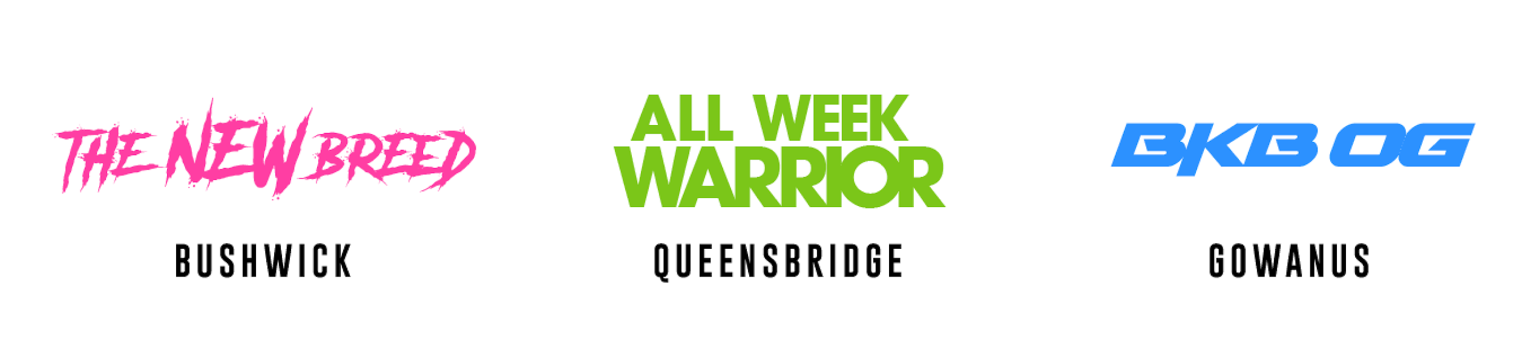
WHO ARE THE HEROES?
Meta, edgy, trendy, androgynous, pansexual, polyamorous, artistic, provocative, scrappy.
A hotbed of New York City college kids. The new thought-leaders of every community are here. People come to Bushwick to find and define themselves.
Hard-working, no-nonsense, strong, graceful, hungry. Queensbridge/LIC is where the working class and a new upper-middle class collide. People here are determined and hard working. They fight for absolutely everything they have, whether it is a little or a lot.
Pride lives here, and it is powerful. Rock steady, defined, and insightful. Gowanus is our most stable and economically developed community. The people here have a true New York grit with a sense of refinement. They are leaders who have climbed and clawed their way to the tops of their mountains.
Notes:
These are our heroic archetypes. And they will become much more than spirit-animals for each facility. But before we get there, let’s look at who they are.
Bushwick IS The New Breed: They are tragically hip people. A high concentration of “cool” lives here.
Queensbridge is represented by the All Week Warrior archetype. These people FIGHT — whether they work 2 jobs a day or have a CTO title.
Gowanus is our BKB OG. The people here have a strength and character to them that comes with age… and that strength + character also comes from being a beast in the boardroom and earning a pretty penny.
NOW we are going to dig into just some of the data behind these character portraits.

Slide 12
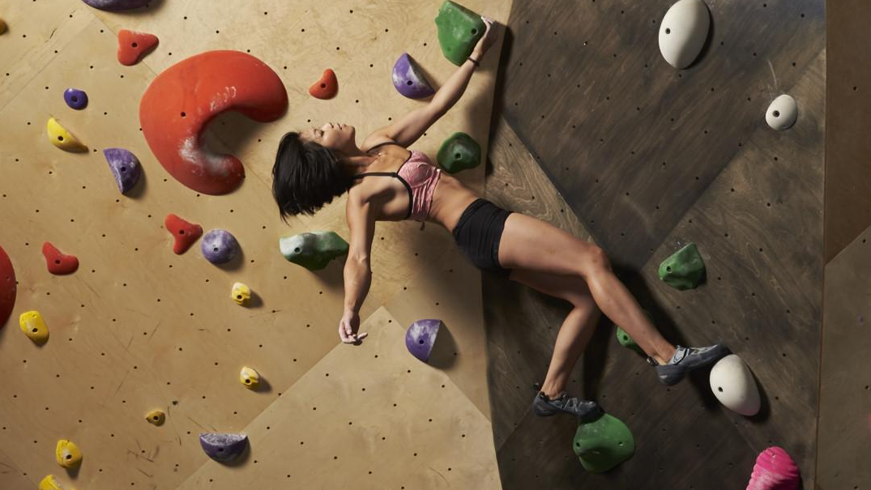
BUSHWICK
THE NEW BREED

Slide 13
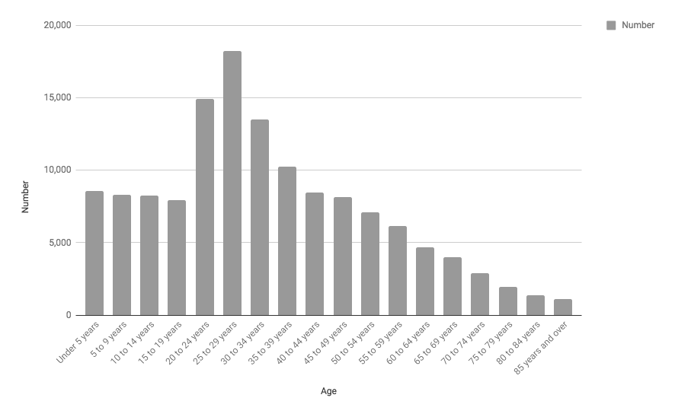
BUSHWICK AGE GROUPS
*Insights pulled from NYC Planning Population FactFinder, which uses data from decennial censuses and the American Community Survey.
Notes:
Total Bushwick Population: 135,837 people
Bushwick is our LARGEST community. Even though Gowanus & Queensbridge will have age brackets that show a higher percentage (relative to its total population) Bushwick has the most people in each and every age group.
The strongest age brackets are 25 - 29 year olds at 13.4% (18,238 ) of the local population, followed by 20 - 24 year olds at 11.0% (14,940). This is NYC’s new college town.
Largest pop. of under-5 through 14 year olds
Under 5 (8,561 — 6.3%)
5 - 9 (8,280 — 6.1%)
10 - 14 (8,245 — 6.1%)
Under 5 through 14: 25,086
The population is nearly evenly divided between:
Family Households 57.6%
Non-Family Households vs 42.4%.

Slide 14
BUSHWICK HOUSEHOLD INCOME
INCOME
NO. OF HOUSEHOLDS
NEIGHBORHOOD PERCENTAGE
Total households
Household income < $10,000
$10,000 to $14,999
$15,000 to $24,999
$25,000 to $34,999
$35,000 to $49,999
$50,000 to $74,999
$75,000 to $99,999
$100,000 to $149,999
$150,000 to $199,999
$200,000 or more
45,463
6,457
3,543
5,627
3,986
5,817
7,489
4,571
5,273
1,590
1,110
100.0%
14.2%
7.8%
12.4%
8.8%
12.8%
16.5%
10.1%
11.6%
3.5%
2.4%
*Insights pulled from NYC Planning Population FactFinder, which uses data from decennial censuses and the American Community Survey.
Notes:
The largest income bracket is $50,000 to $74,999, made by 16.5% of the neighborhood. The second largest income bracket is Household income of less than $10,000, made by 14.2% of the neighborhood. The third largest income bracket is $35,000 to $49,999 made by 12.8% of the neighborhood.
Education, the arts/entertainment, food service, and retail are the top industries Bushwick residents work in.

Slide 15
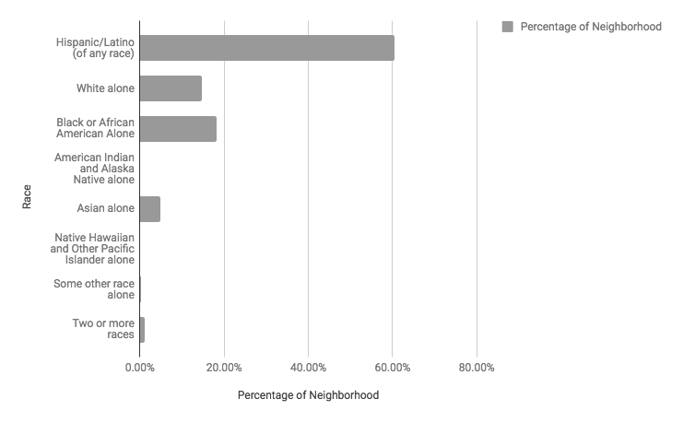
BUSHWICK RACE
*Insights pulled from NYC Planning Population FactFinder, which uses data from decennial censuses and the American Community Survey.
Notes:
Bushwick is predominantly “Hispanic/Latino (of any race),” accounting for 60.5% of the neighborhood. The remaining 39.5% is split between “Black or African American Alone” at 18.3% of the neighborhood and “White alone” at 14.8% of the neighborhood.

Slide 16
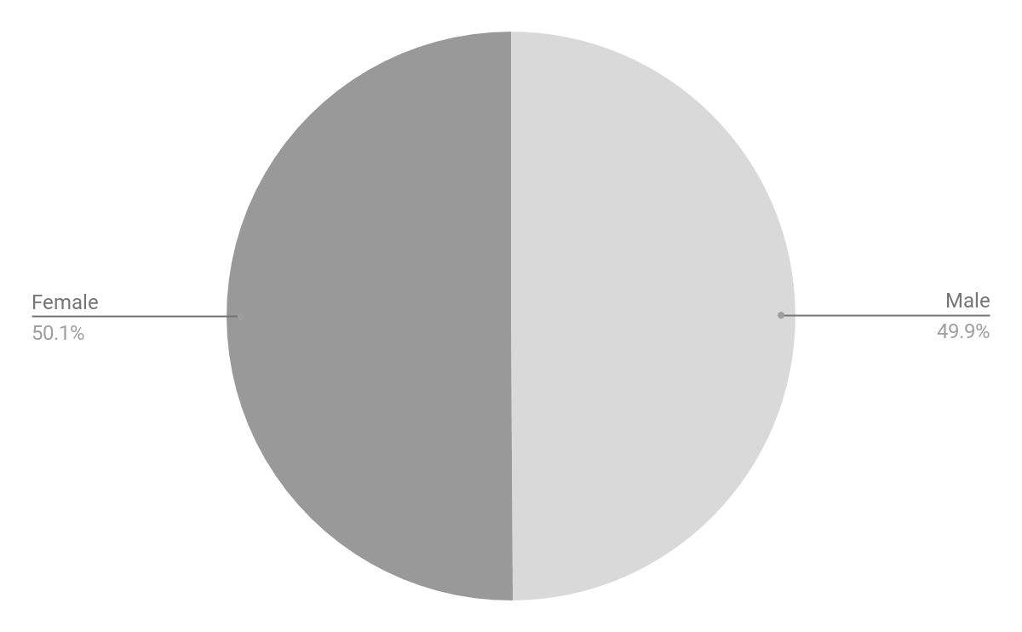
BUSHWICK GENDER
*Insights pulled from NYC Planning Population FactFinder, which uses data from decennial censuses and the American Community Survey.
Notes:
Bushwick is 50.1% female and 49.9% male.
Our transgender population is completely unaccounted for — in all our neighborhoods. Sadly, the census has not developed any methods of addressing this. And it looks like the 2020 census will still leave LGBTQ+ people and communities unaccounted for.

Slide 17

QUEENSBRIDGE
ALL-WEEK
WARRIORS

Slide 18
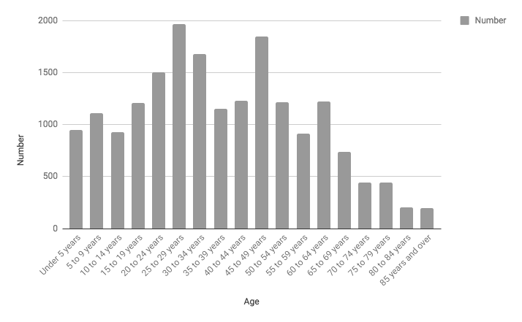
QUEENSBRIDGE AGE GROUPS
*Insights pulled from NYC Planning Population FactFinder, which uses data from decennial censuses and the American Community Survey.
Notes:
Total Queensbridge Population: 18,927 people
The strongest age brackets are 25 - 29 year olds at 10.4% (1,964) of the local population, followed by 45 - 49 year olds at 9.8% (1,847), closely followed by 30 - 34 year olds at 8.8% (1,675) of the neighborhood.
The population is nearly evenly divided between Family Households and Non-Family Households: 56.6% vs 43.4%.
Queesbridges is currently our smallest community. It is being heavily developed, and its future is not being foreshadowed by the current census. Our presence there is a true investment in the near future — and it is an opportunity to soon be seen as a “fixture” by the new wave of people who will be moving to Queensbridge/LIC

Slide 19
QUEENSBRIDGE HOUSEHOLD INCOME
INCOME
NO. OF HOUSEHOLDS
NEIGHBORHOOD PERCENTAGE
Total households
Household income < $10,000
$10,000 to $14,999
$15,000 to $24,999
$25,000 to $34,999
$35,000 to $49,999
$50,000 to $74,999
$75,000 to $99,999
$100,000 to $149,999
$150,000 to $199,999
$200,000 or more
7,805
1,353
992
1,216
808
914
927
666
510
215
204
100.0%
17.3%
12.7%
15.6%
10.4%
11.7%
11.9%
8.5%
6.5%
2.8%
2.6%
*Insights pulled from NYC Planning Population FactFinder, which uses data from decennial censuses and the American Community Survey.
Notes:
The largest income bracket is Household income of less than $10,000, made by 17.3% of the neighborhood. The second largest income bracket is $15,000 to $24,999, made by 15.6% of the neighborhood.
That said, we see an even spread of the local population across the $25,000 to $74,999 range.
Education, the arts/entertainment, food service, and retail are the top industries Queensbridge residents work in.
DEVELOPMENTS AND AFFLUENCE NOT ACCOUNTED FOR IN THE CENSUS

Slide 20
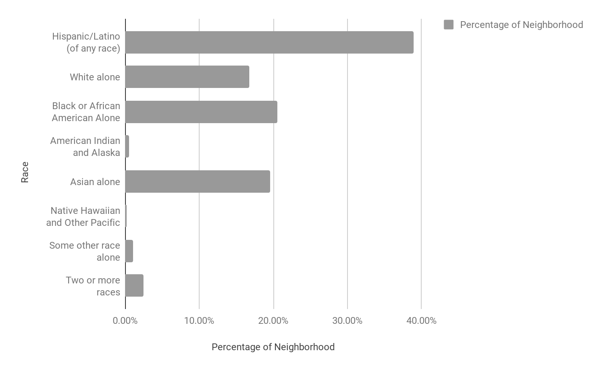
QUEENSBRIDGE RACE
*Insights pulled from NYC Planning Population FactFinder, which uses data from decennial censuses and the American Community Survey.
Notes:
Queensbridge/LIC is predominantly “Hispanic/Latino (of any race),” accounting for 38.9% of the neighborhood. The remaining 61.1% is split between “Black or African American Alone” at 20.5% of the neighborhood, “Asian alone” at 19.6%, and “White alone” at 16.8% of the neighborhood.

Slide 21
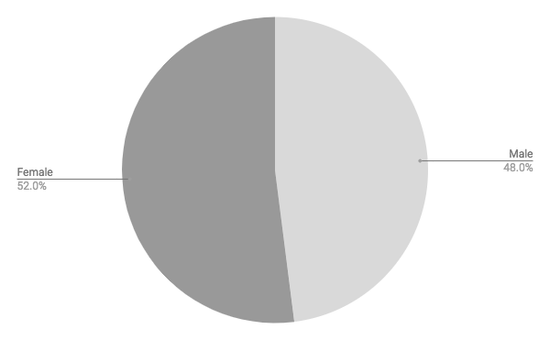
QUEENSBRIDGE GENDER
*Insights pulled from NYC Planning Population FactFinder, which uses data from decennial censuses and the American Community Survey.
Notes:
Queensbridge/LIC is 52% female and 48% male.

Slide 22
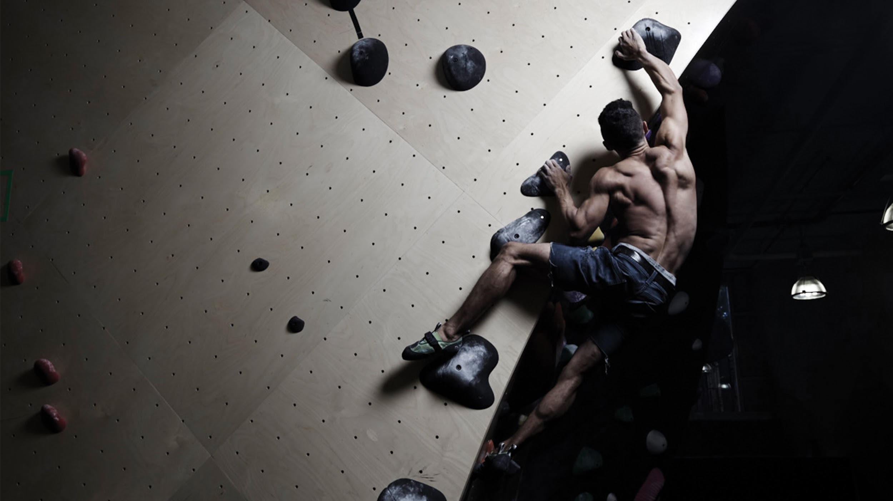
GOWANUS
BKB OG

Slide 23
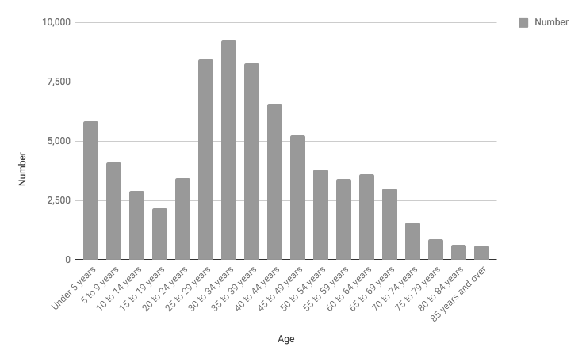
GOWANUS AGE GROUPS
*Insights pulled from NYC Planning Population FactFinder, which uses data from decennial censuses and the American Community Survey.
Notes:
Total Gowanus population: 73,881 people
The strongest age brackets here are 30 - 34 year olds year olds at 12.5% (9,258) of the local population, followed by 25 - 29 year olds at 11.5% (8,473), and 35 - 39 year olds at 11.2% (8,293) of the neighborhood.
The population is nearly evenly divided between Family Households and Non-Family Households: 54.2% vs 45.8%.

Slide 24
GOWANUS HOUSEHOLD INCOME
INCOME
NO. OF HOUSEHOLDS
NEIGHBORHOOD PERCENTAGE
Total households
Household income < $10,000
$10,000 to $14,999
$15,000 to $24,999
$25,000 to $34,999
$35,000 to $49,999
$50,000 to $74,999
$75,000 to $99,999
$100,000 to $149,999
$150,000 to $199,999
$200,000 or more
31,147
1,197
719
1,010
1,102
2,273
3,682
3,721
5,877
4,113
7,453
100.0%
3.8%
2.3%
3.2%
3.5%
7.3%
11.8%
11.9%
18.9%
13.2%
23.9%
*Insights pulled from NYC Planning Population FactFinder, which uses data from decennial censuses and the American Community Survey.
Notes:
The largest income bracket is $200,000 or more, made by a considerable 23.9% of the neighborhood. The second largest income bracket is $100,000 to $149,999, made by 18.9% of the neighborhood, followed by $150,000 to $199,999 made by 13.2% of the neighborhood.
Professional/scientific/management, education, the arts, finance/real estate, and information are the top industries Gowanus residents work in.
Gowanus is the most stable neighborhood income-wise.

Slide 25
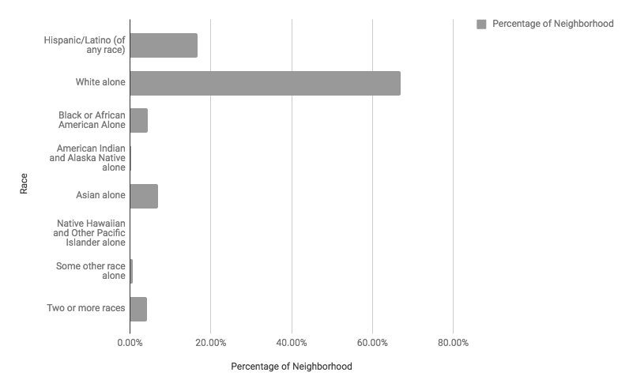
GOWANUS RACE
*Insights pulled from NYC Planning Population FactFinder, which uses data from decennial censuses and the American Community Survey.
Notes:
Gowanus is predominantly “White alone” accounting for 66.9% of the neighborhood. “Hispanic/Latino (of any race)” account for 16.7% of the population while “Asian alone” makes up 7% of the neighborhood, and “Black or African American Alone” makes up 4.4%.

Slide 26

GOWANUS GENDER
*Insights pulled from NYC Planning Population FactFinder, which uses data from decennial censuses and the American Community Survey.
Notes:
Gowanus is 51.9% female and 48.1% male.

Slide 27
MEET
OUR
HEROES
MEMBER
FIRST
MARKETING

Slide 28
MEET OUR HEROES:
MEMBER-BASED VIDEO SERIES
Episodic and evocative.
Stories of community, surmounting hardship, and being empowered by BKB.
Relatable people, aspirational spirits.
Notes:
BKB: Be Your Hero’s heart and soul — the campaign’s driving force — is the “Meet Our Heroes” video series.
Meet Our Heroes tells our members’ stories through episodic, evocative, documentary video-shorts. We will discover who they are, where they come from, what communities they identify with, what being an individual in a community means, the joy and responsibility of that, and most importantly how Brooklyn Boulders empowers them.
We will focus on relatable people with aspirational spirits. They are us, and they are who we want to be.
Their stories will live primarily on YouTube, but we will leverage a multi-channel approach to telling their stories.
With Bushwick and Queensbridge “Meet Our Heroes” videos we will share stories of self-actualization, reaching full potential, transformation. These stories will be the classic Hero’s Journey — people who go forth, break beyond boundaries, acquire newfound strength and personal insights, and find ways to give those gifts back to their communities. Whether it’s their family, friends, or neighborhood.
With Gowanus, we will here stories from people who have reached the mountain top. We will hear stories from hardcore climbers with the presence of champions, and we will learn how they feel senses of hope, happiness, gratitude, and love when they see the youth — the future — training at BKB Gowanus. We will hear how this current generation of accomplished BKB climbers looks to invest their time and efforts into the children.
Another strong narrative for Gowanus is one that speaks to the trust, family, consistency, and dependability of BKB. It will be a story of strong bonds built with the BKB: Gowanus. It will be a story of how a family knows that BKB builds better futures for their children.

Slide 29
THEIR
STORIES
CONTINUE
MULTI
CHANNEL
COMMUNICATION

Slide 30
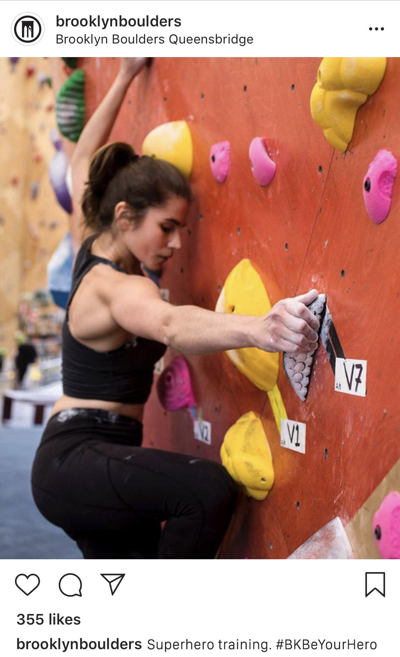

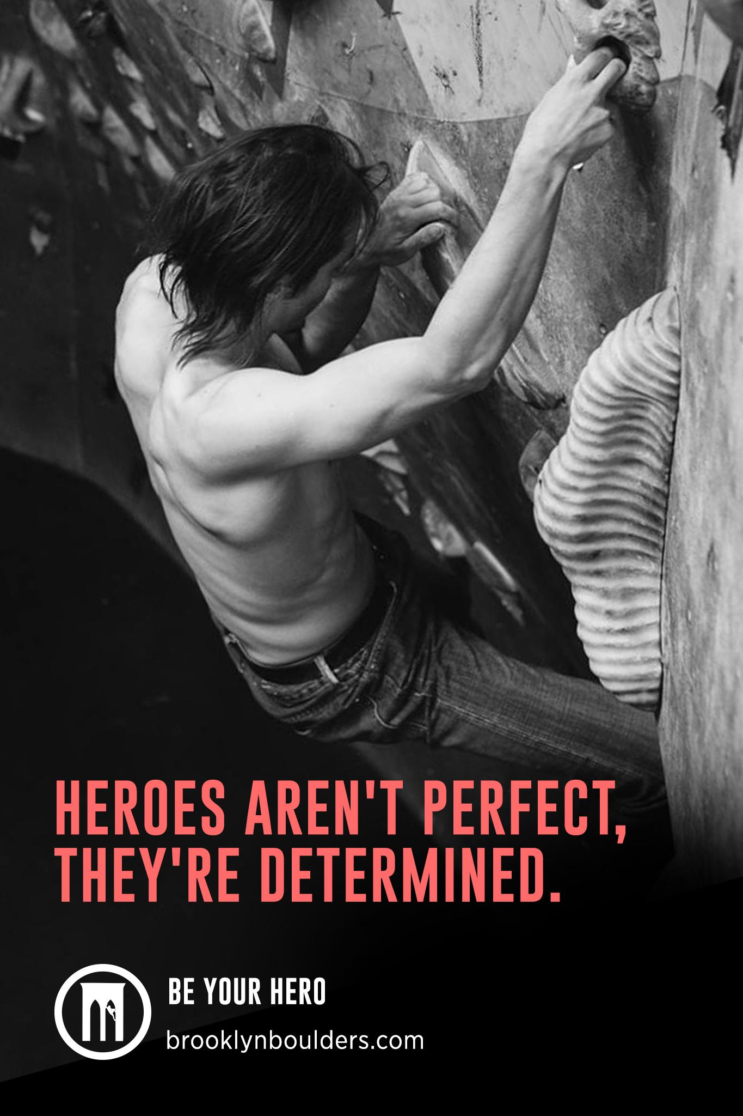
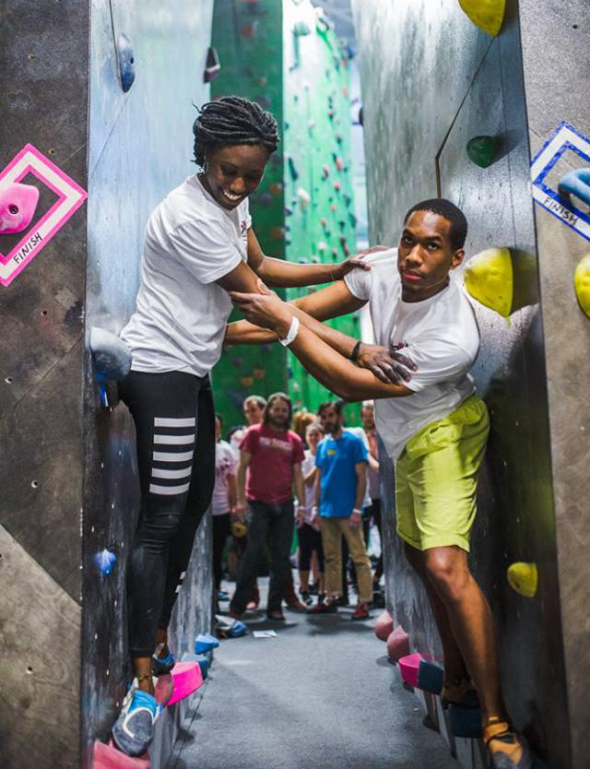
THEIR STORIES CONTINUE: SOCIAL + MEDIA OUTREACH + ADS
SOCIAL MEDIA
Our heroic members’ stories will be told not only via our video series, but also with carefully crafted social content, supplementing the main narrative.
NEWS STORIES
Strategic placement in media outlets like Vice wil link an audience that lives on content directly to our video series.
AD
Our heroic members will also be the focus of our local digital and subway advertising. This will further exalt our subjects, and also excite current and future members.
Notes:
Our heroes and their stories will provide us with a wealth of communication material.
We have our owned media like social media to tell our members’ stories. This will allow for dynamic storytelling After their stories end on YouTube, we will be able to keep up with them and hear from them via IG posts, IG Stories, IGTV, and carefully promoted Facebook Live events.
Our members’ inspirational stories will also open up opportunities for media placement. We can craft a compelling hook here. Not many companies turn their actual customers into superheroes — superheroes they build quality content around. The more authentic, honest, and compelling our videos — the more we give media something to bite into.
Lastly our members — real people, real NEW YORKERS — will be the stars of our localized advertising, both outside/subway and digital. And let me tell you, as a born and raised New Yorker… the only thing that tops the idea of seeing myself on a subway ad is getting a bench dedicated to me in Central Park. Featuring our members as the focal point of our advertising will be powerful, it will be authentic, and we’ll be making people feel great.

Slide 31
LIVE
THE
LIFESTYLE
ADD
VALUE +
INVITE

Slide 32
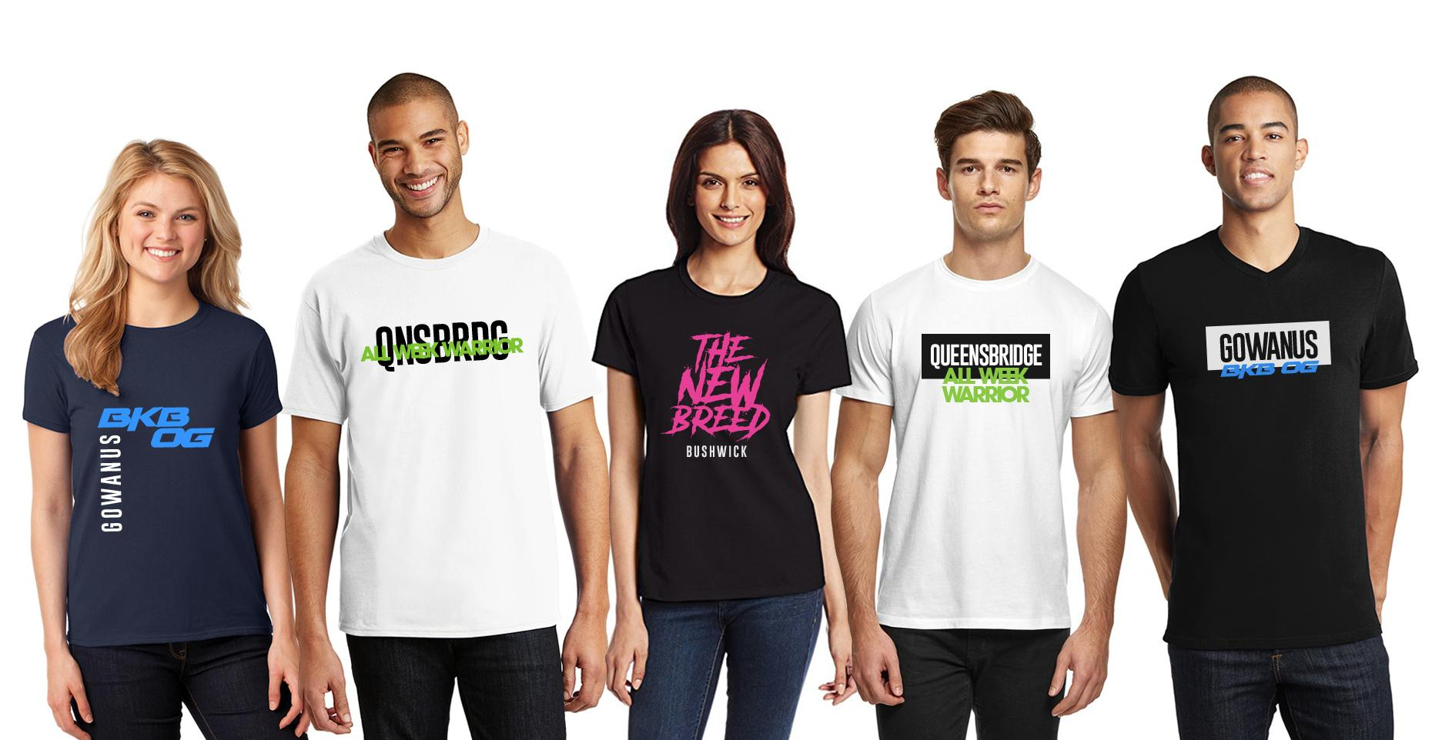
LIVE THE LIFESTYLE:
FACILITY-SPECIFIC MERCHANDISE
Notes:
And now we’re back to our heroic archetypes. These character breakdowns will allow for facility-specific merchandise opportunities. This will give further definition and differentiation between each location. And this facility-specific merch lays the foundation for what’s to come.
But first, our events...

Slide 33
LIVE THE LIFESTYLE:
BE YOUR HERO EVENTS
Bushwick
Heroic Preparations:
Theatrical Fight Choreography Workshop
Practical Jiu-jitsu Workshop from Masterskya
Become Your Hero:
T-Shirt Airbrushing & Face Makeup
Ninja Warrior Style Heroic Obstacle Course
Recover + Relax:
Snacks by RxBar
Beer by Kings County Brewers Collective
Queensbridge
Heroic Preparations:
Capoeira Workshop
Stunt Workshop by Hollywood Stunts NYC
Become Your Hero:
T-Shirt Airbrushing & Face Makeup
Ninja Warrior Style Heroic Obstacle Course
Recover + Relax:
Snacks by RxBar
Beer by LIC Beer Project
Gowanus
Heroic Preparations:
Parkour Training for Climbers
Self-Defense Workshop from C1MMA
Become Your Hero:
T-Shirt Airbrushing & Face Makeup
Ninja Warrior style heroic obstacle course
Recover + Relax:
Snacks by RxBar
Beer by Threes Brewing
Notes:
These sample events listed here are examples of what we can do to make our members really feel like superheroes. Ideally, each facility will get a healthy mix of “legitimate” heroic martial arts experiences AND fun, safe, and fantasy based experiences — like stunt workshops and fight choreography.
We can then encourage our members to discover and develop their personal heroic identities. We will offer them airbrushing stations and face makeup/war paint stations.
And then, of course, we need to put our heroes to the test with some Ninja Warrior style obstacle courses. I saw that was used in previous events, and it is just too cool of an opportunity to not use it here. And we have to offer it to each location.
We round these events out with nutrition by RxBar and beer provided by three distinct and loved local breweries.

Slide 34
BE YOUR
HERO
IN ACTION
COMPETITION
CREATIVITY
COMMUNITY

Slide 35
Be Your Hero in Action:
Competition + Creativity + Community
Notes:
These are not just location-based character-archetypes. These aren’t just logos for facility-specific t-shirts.
These are teams. And we will see our members compete in trials to represent their home facility.
Our inaugural interfacility competition will be the culmination of our BKB: Be Your Hero campaign. We will declare a winning facility, and 1st, 2nd, and 3rd place individual participants.
This will create a new culture at BKB. Within 3 years we could have smaller “climbing-clubs” develop at each location. Like how in soccer, each country has its own individual football-clubs, and then their national teams. These smaller climbing clubs will compete with each other before major competitions to see who makes each larger facility-wide team.
And within 3 years we could establish 3 unique and equally important flagship competitions — resulting in an opportunity for one facility and one member each year to earn the Brooklyn Boulders: Triple Crown.
Now, imagine a future maybe 5, 6, 7 years down the line, maybe even more… But a future where we have BKB interfacility competition on a national level. The possibilities and opportunities are there.
A digital hub that offers historical stats, and has features like a digital “Hall of Heroes” where members can learn about past winners and all their achievements will allow this initiative to become a deeper and ongoing experience.

Slide 36
CAMPAIGN
ECOSYSTEM
CALENDAR

Slide 37
Direct:
Indirect:
CAMPAIGN ECOSYSTEM
PAID SEARCH + PAID SOCIAL
OUTDOOR/SUBWAY ADS
VIDEO SERIES
ORGANIC SEARCH
EVENTS + COMPETITIONS
ORGANIC SOCIAL
WEBSITE/CONSIDERATION
MEDIA COVERAGE
MERCH
MEMBERSHIP
Notes:
Here is our campaign ecosystem. It takes our campaign structure from earlier and demonstrates the symbiosis at play.
This is a visualization of the interplay between our tactics, and how they share responsibilities and support each other to achieve our goals.

Slide 38
Calendar
TASK 1: ESTABLISH
Q1
Q2
Q3
Q4
JAN
FEB
MAR
APR
MAY
JUN
JUL
AUG
SEP
OCT
NOV
DEC
“Meet Our Heroes” Video Series 1
“Meet Our Heroes” Video Series 2
“Meet Our Heroes” Video Series 3
Social Support for the BKB: Be Your Hero Campaign — “Meet Our Heroes Video Series,” Be Your Hero Events, & Interfacility Competition
“Meet Our Heroes” Press
“Meet Our Heroes” Press
“Meet Our Heroes” Press
BKB: Be Your Hero Ads — Facebook, Google, + Strategic Subway Placements
TASK 2:
ADD VALUE
Bushwick
Be Your Hero Event
Queensbridge Be Your Hero Event
Gowanus
Be Your Hero Event
Merch Drop 1
Merch Drop 2
Merch Drop 3
TASK 3:
INVITE
Inaugural Interfacility Competition
Notes:
Now that we’ve seen the structure and interplay between our strategy’s various tactics, we can take a look at our timeline.
This proposed timeline, in my mind, is 2019. But truly, we can execute this whenever we are confident in it and its timing.
Over the first 3 quarters of “2019” we will release our video series. We will release it in 3 waves.
Our first Bushwick-based “Meet Our Heroes” will release in Jan 2019, followed by our first Queensbridge video in February, followed by our first Gowanus video in March. That pattern will repeat until all 9 videos have been released — ending in Sept. 2019 — the end of 2019’s 3rd Quarter.
We will have strategic media partnerships to debut, at least, each wave of videos — if not media partnerships for all 9 individual videos. Depending on a number of factors, this can be a relaxed or aggressive media relations strategy.
Throughout all 4 Quarters we will see time-appropriate social media support for the BKB: Be Your Hero campaign. This will include social support for our video series, events, and eventually our inaugural interfacility competition.
Over 9 months spanning Q1 through Q4 we will engage in BKB: Be Your Hero inspired advertising at a very local and targeted level. We will call out essential train lines for subway ads, and we will use Facebook ads to deliver localized digital advertising to the people who need to see it.
The first 3 Qs of 2019 will have 1 event and associated merch drop.
This culminates with our first eve interfacility competition in November of 2019 — a sort of winter classic, but the beginnings of much more than that.

Slide 39
“WE CANNOT LOWER THE MOUNTAIN, THEREFORE WE MUST ELEVATE OURSELVES.”
TODD SKINNER

Slide 40
B R O O K L Y N B O U L D E R S

