Slide 1


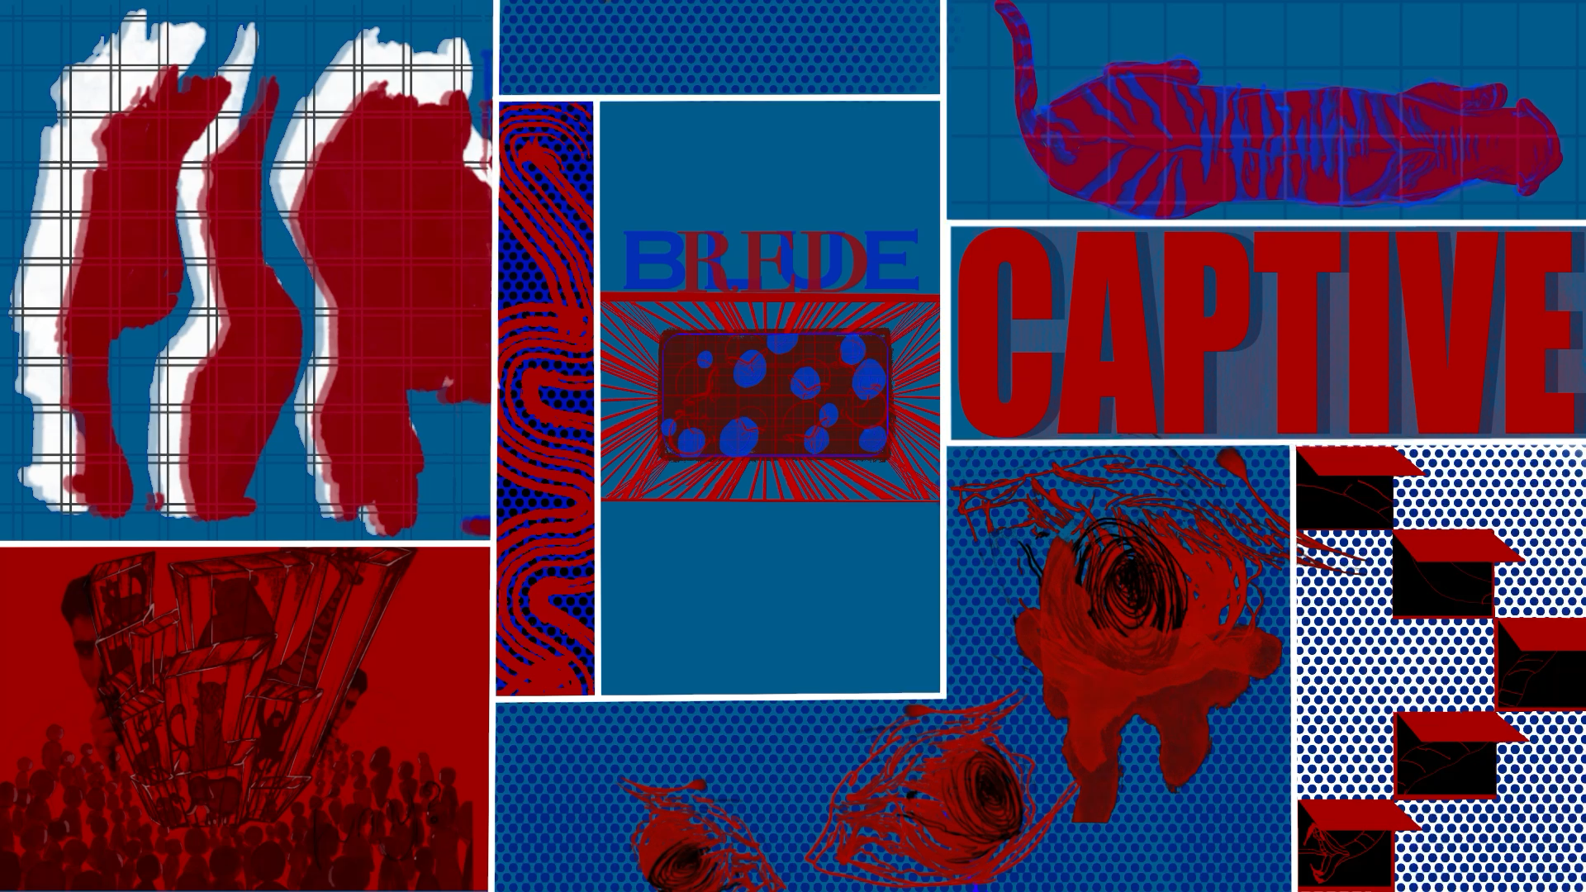
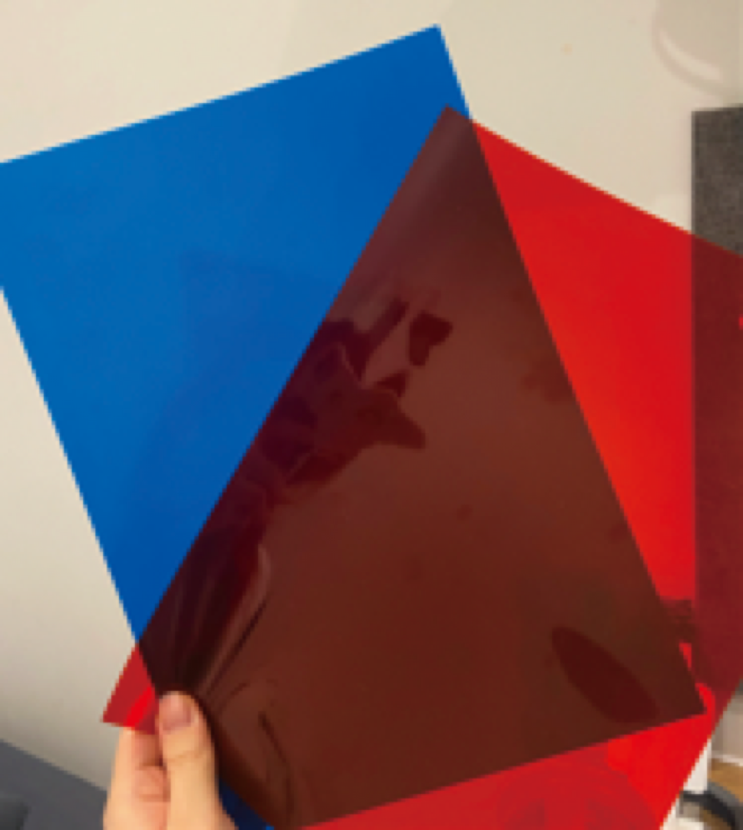
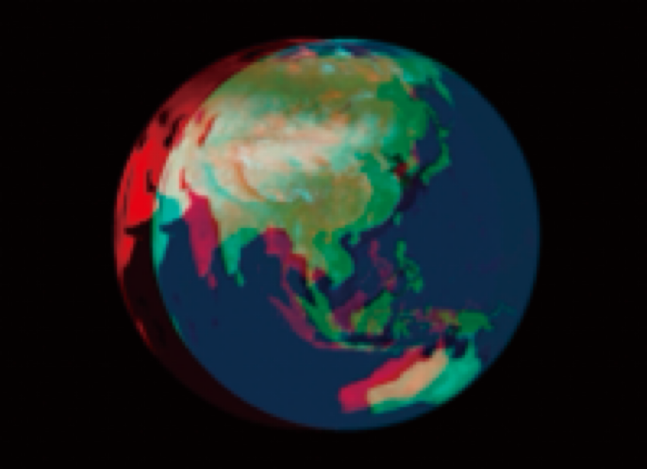

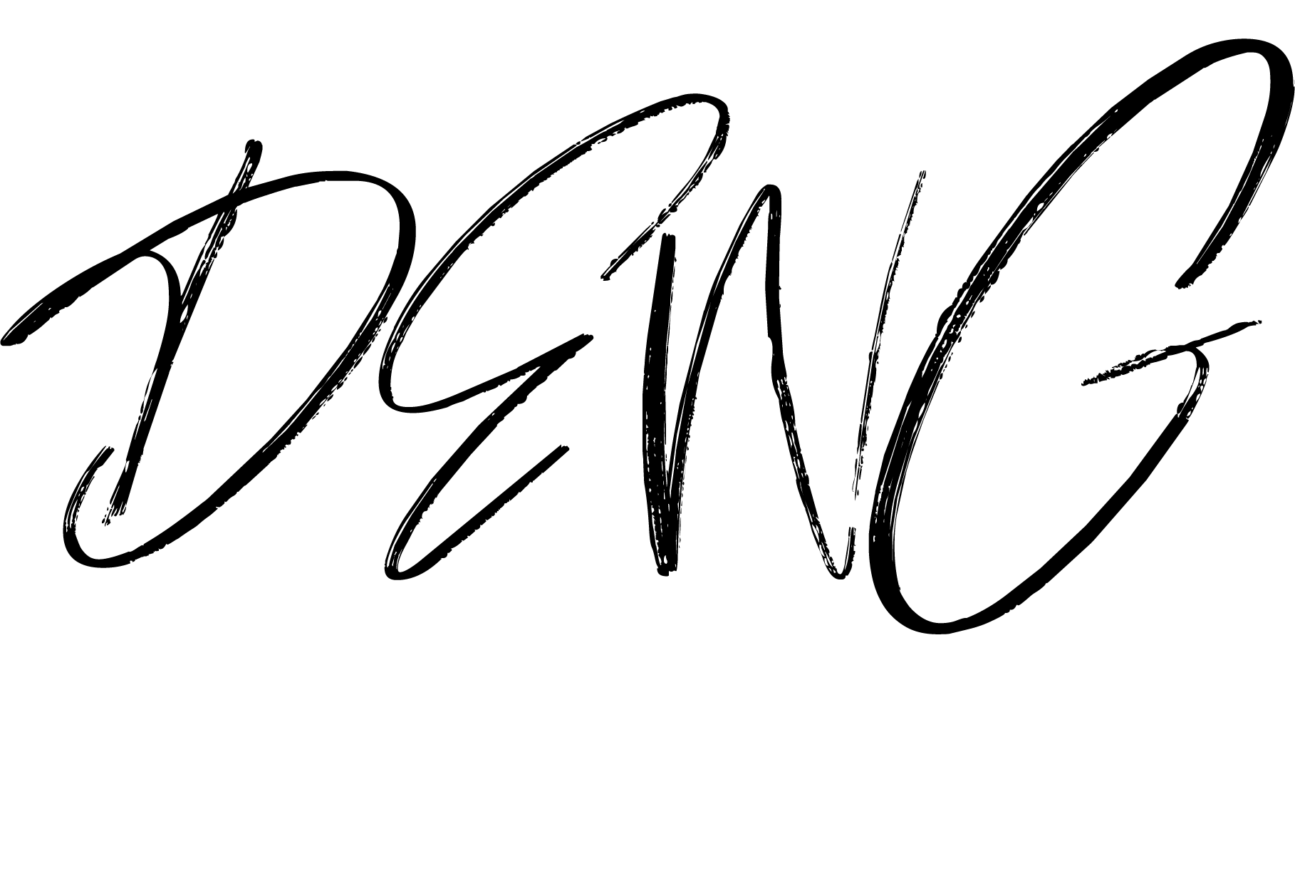
ANAGLYPH
OVERLAP BLUE AND RED ANIMATION PART
Contrasting Superficial Manifestations and Internal States in Animal Stereotypic Behavior

