Slide 1
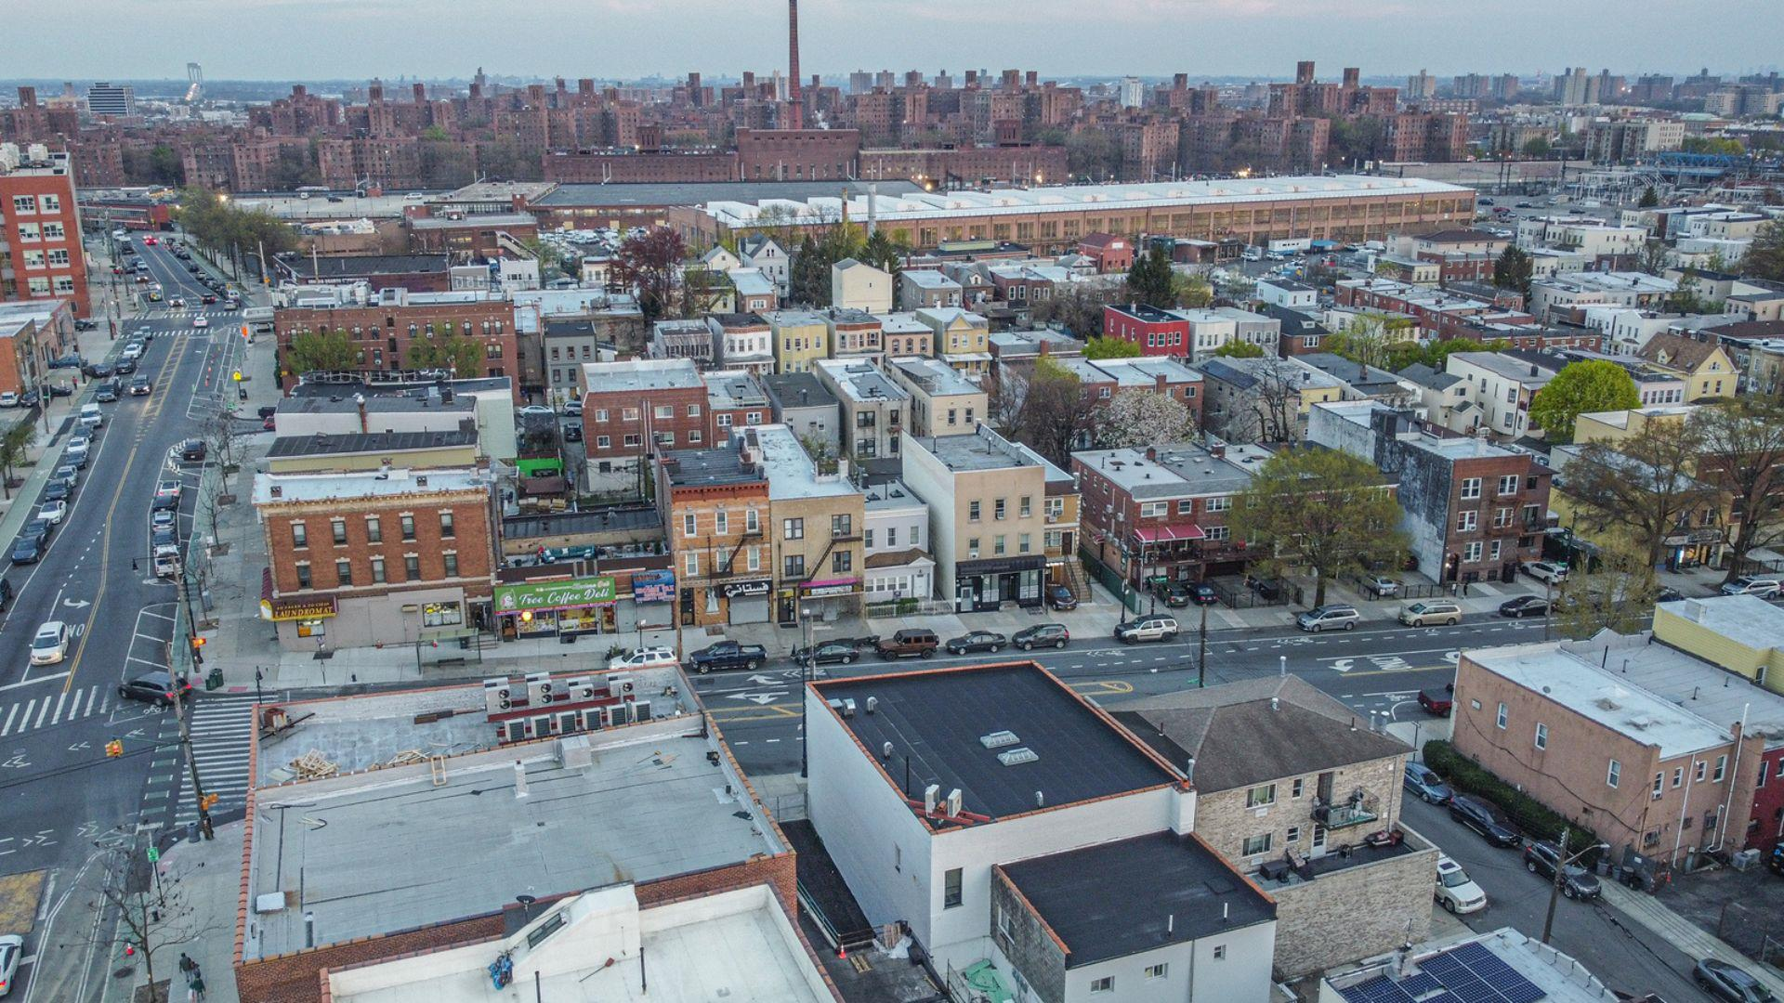

GREATER
MORRIS PARK
Downtown Revitalization Initiative
Public Workshop #1
June 10, 2025

Slide 2
Agenda
1.
2.
3.
4.
5.
Welcome and Introduction
Overview of the DRI Process
Open Call for Projects
Public Engagement
Next Steps

Slide 3
State Team
Roles & Responsibilities
Lead and guide the entire DRI planning process and oversee project implementation thereafter
Manage and assist the consultant team
Participate in preparation and review of DRI / NYF documents
Engage other State agencies, when needed
NYS Department of State
Jeannette Rausch
NYC Region DRI Lead
Empire State Development
Joe Tazewell
NYC Regional Director
Homes and Community Renewal
Adrian Halvorsen
Project Manager
NYSERDA
New York State Energy Research and Development Authority

Slide 4



Consultant Team
Prime Consultant
Contact:
Shachi Pandey, AICP, LEED AP
Project Management
Community and Stakeholder Outreach
Urban Design and Planning
Project Feasibility and Development
Roles & Responsibilities:
Lead all public engagement
Prepare program documents
Assist LPC with identification, development, and evaluation of potential projects
Conduct research, as necessary
Economic Analysis
Project Feasibility and Development
Costing and Estimation

Slide 5
Local Planning Committee (LPC)
P
LPC CO-CHAIRS
Vanessa Gibson
Bronx Borough President
Lisa Sorin
Bronx Chamber of Commerce
Amr Abozaid
Yemeni American Merchants Association
Viviana Bianchi
Bronx Council of Arts
Yasmin Cruz
Westchester Square BID
Matthew Cruz
Community Board 10
Bernadette Ferrara
Van Nest Neighborhood Alliance
William (Bill) Foster
Neighborhood Initiatives Development Corporation (NIDC)
Francina Frias
NY Public Library, Morris Park Branch
Megan Guy
Simone Development Corporation
Dr. Camelia Tepelus
Morris Park BID
Anderson Torres
R.A.I.N. Total Care Inc
Rob Walsh
Bronx Economic Development Corporation
Jeremy H. Warneke
Community Board 11

Slide 6
Agenda
1.
2.
3.
4.
5.
Welcome and Introduction
Overview of the DRI Process
Open Call for Projects
Open House and Public Workshop
Next Steps
Overview of
the DRI Process

Slide 7
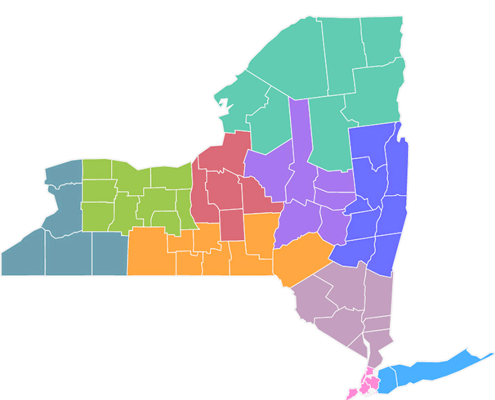
NYS Downtown Revitalization Initiative - Round 8
Across the state, the New York State’s Downtown Revitalization Initiative (DRI) seeks to invest in communities that are “ripe for revitalization and have the potential to become a magnet for redevelopment, business, job creation, greater economic and housing diversity, and opportunity.”
Selection Criteria:
Physical features that promote a livable,
mixed-use downtown
Recent or impending job growth
Ability to leverage additional public and private investment
Commitment from local leaders
Greater Morris Park

Slide 8





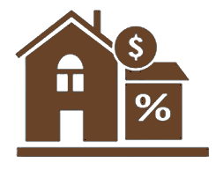

DRI Program Goals
Provide enhanced public spaces that serve those of all ages and abilities
Create an active downtown with a mix of uses and businesses
Grow the local property tax base
Provide diverse employment opportunities for a variety of skill sets and salary levels
Encourage the reduction of greenhouse gas emissions
  Create diverse housing options for all income levels​​​
Enhance downtown living and quality of life

Slide 9



DRI Process
PLAN
April – November 2025
APPLY
July - December 2024
IMPLEMENT
2026 - 2031
Communities work with respective BPs to prepare neighborhood proposals.
BPs submit up to two applications to NYC REDC.
REDC nominates community to the State.
State announces winners.
Local Planning Committees are established.
Community vision and goals are refined.
Projects are identified and refined.
LPC recommends projects to State.
Final SIPs submitted to the State.
Following review State announces which Priority Projects are funded.
State executes individual project contracts.
Project Implementation within five-year window.
OUR FOCUS IS HERE!

Slide 10
DRI Planning Process
1/
2/
3/
4/
Strategic Investment
Plan
Past Plans & Investments
Public Engagement Strategies
Downtown Profile & Assessment
Community Vision, Goals, & Strategies
Project Development
Public Engagement Throughout Planning Process

Slide 11
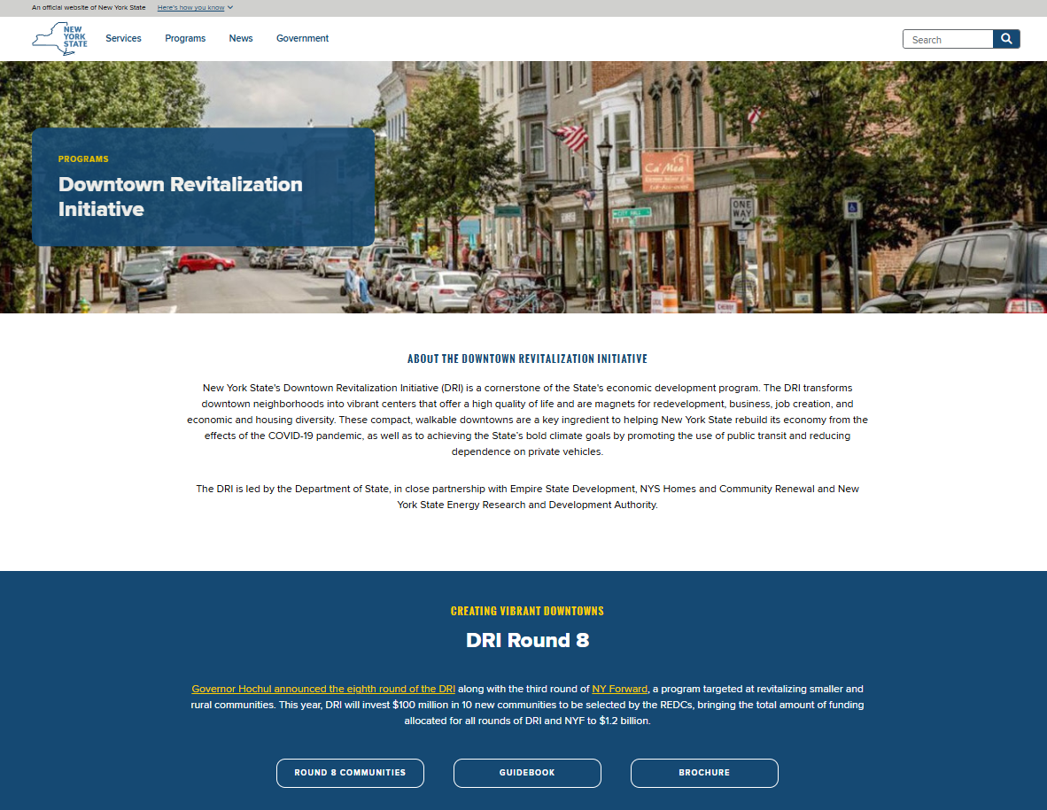
Goals of DRI Planning Process
Consensus on a recommended list of Priority Projects for implementation and scope of work in each project.
​Submission of a Strategic Investment Plan (SIP) to the State containing recommended list of projects with profile of the area.
Momentum and direction for downtown revitalization.

Slide 12
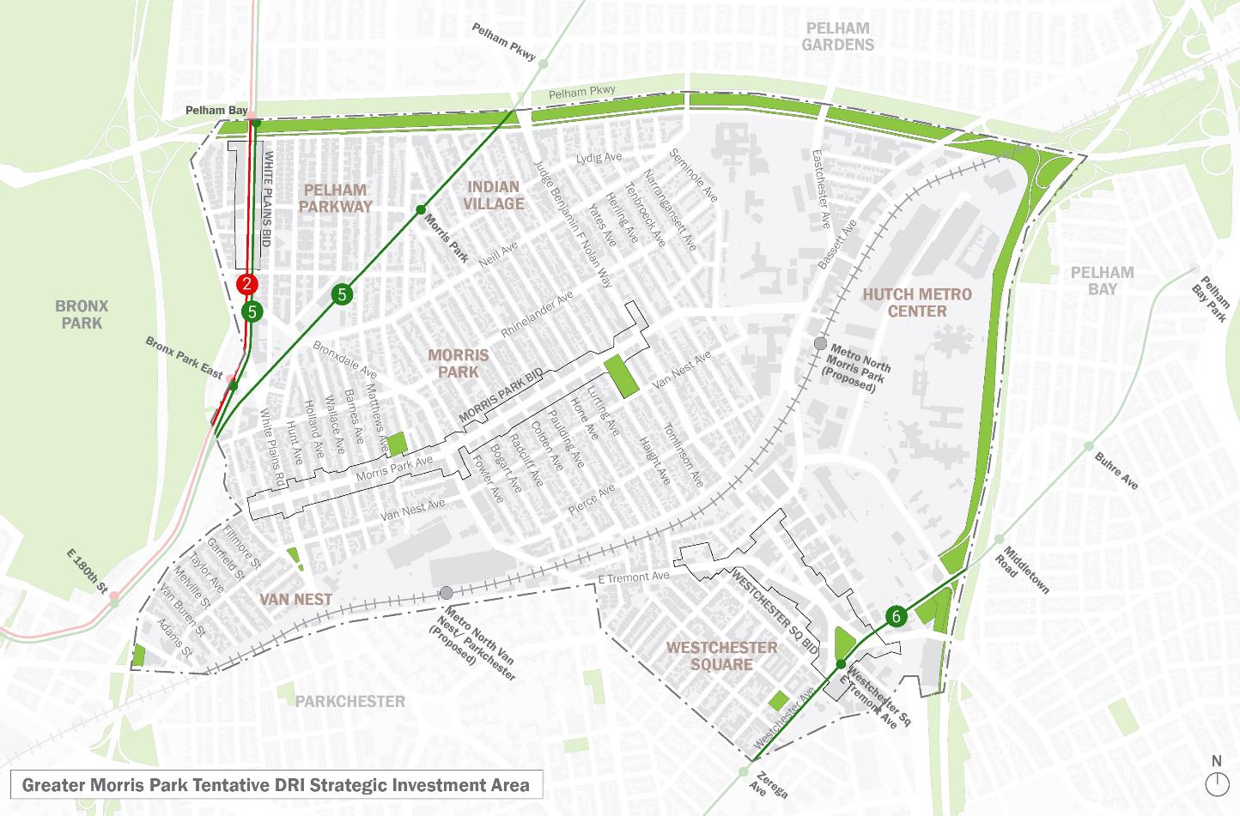
DRI Investment Area (Tentative Boundary)
  The tentative DRI boundary is established through the application process.
  The DRI Investment area should focus on core downtown local business, shopping, and cultural corridors and landmarks.
  Once the Call for Projects closes, the LPC establishes the final DRI Investment Area.
  DRI funds can only be used for projects with the DRI Investment Area.

Slide 13
Timeline
Project Timeline
You are here!
APRIL
MAY
JUNE
JULY
AUG
SEPT
OCT
NOV
LPC Meetings
1
2
3
4
5
6
Downtown Profile & Assessment
Community Vision, Goals, and
Revitalization Strategies
Strategic Investment Plan Development
Open Call for Projects
Project Development
Strategic Investment Plan
Public and Stakeholder Outreach
Public Outreach
1
2
Notes:
Talk about the process of Downtown Profile and Assessment >> What we’re pulling from >> and then share the information about the recent studies and investments.

Slide 14
Agenda
1.
2.
3.
4.
5.
Welcome and Introduction
Overview of the DRI Process
Open Call for Projects
Open House and Public Workshop
Next Steps
Open Call
for Projects

Slide 15
How DRI Projects are Identified & Selected
Strategic Investment Plan
Project
Formation
Project Development
Application
Open Call
Public Input
Eligibility & Technical Review
Cost & Financing Review
Scope Definition & Timing
Sponsor Capacity
Priority Projects
~ $26-32M
The LPC evaluates all projects based on DRI Program criteria and your community goals.
Not all solicited projects will be included in the final Strategic Investment Plan.

Slide 16




Eligible Projects
Public Improvement Projects
New Development and/or Rehabilitation of Existing Downtown Buildings
Small Project Grant Fund
Branding and
Marketing
Streetscape & pedestrian improvements
Complete streets and road diets
Recreational trails
Parks and plazas
Permanent public art
Green Infrastructure & waterfront improvements
Development and redevelopment of real property for mixed-use, commercial, residential, not-for-Profit, or public uses.
Development / redevelopment should result in employment opportunities, expanded housing choices, and/or other community benefits.
A locally-managed matching small project fund (up to $1,000,000)
For small downtown Projects, such as:
Façade improvements,
Building renovations,
Permanent public art.
Downtown branding and marketing projects that target residents, tourists, investors, developers and visitors.
Should result in physical signs.
May include minor digital/on-line/app components.

Slide 17
Ineligible Projects & Activities
Property Acquisition
Training and Other Program Expenses
Expenses related to Existing Programs
Planning Activities
Temporary Art Projects
Operations and Maintenance or Deferred Maintenance
Pre-award Costs

Slide 18
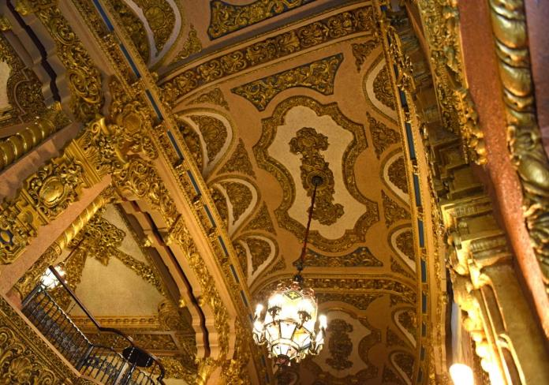
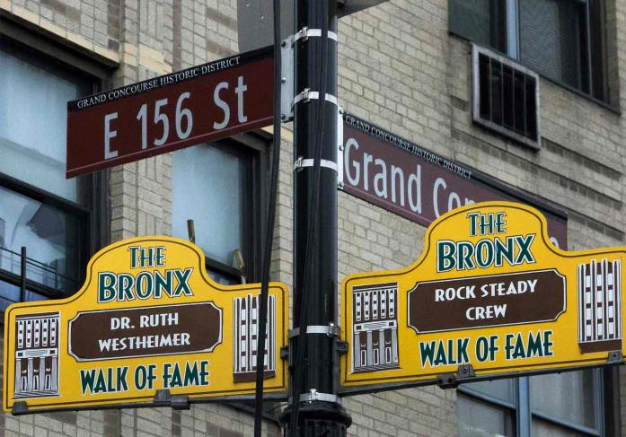
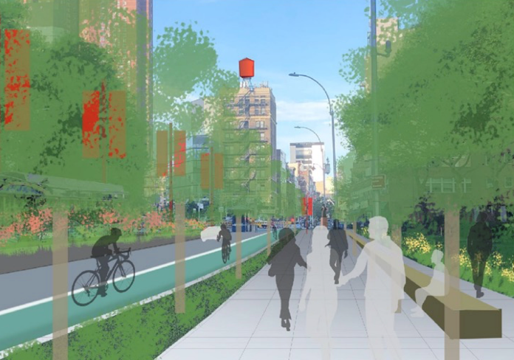
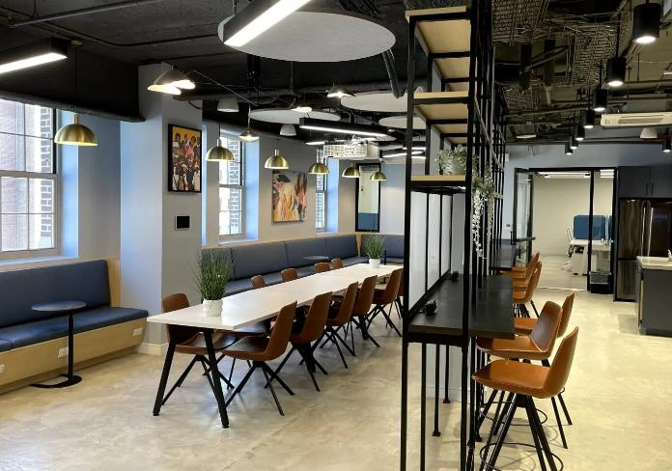
Successful Projects in NYC
  St. George Theatre Staten Island
  Bronx Walk of Fame
  The Bronx
  Greater Nexus
  Co-working Space Jamaica, Queens
  Kimlau Square Chinatown, Manhattan

Slide 19
Launch of Open Call for Projects
Open Call for Projects will be open from June 13 – August 08
1.
Intent to Submit Proposal Form
Requires contact information, project name, project type, and a brief description.
Deadline:
July 25, 2025
by 5pm
2.
(Tentative) Office Hours
July 9 : 10 AM – 11:20 AM July 10 : 3 PM – 4:20 PM
July 15 : 2 PM – 3:20 PM
July 22 : 1 PM – 2:20 PM
Additional project development meetings will be set up with the consultant.
3.
Full Project Proposal Submission
Deadline:
August 08, 2025
by 5pm

Slide 20
Project Development & Evaluation
Is the Project Eligible ?
Does it Align with Local & State Goals ?
Will the Project Advance the Community’s Downtown Vision ?
Will the Project have a Transformative and/or Catalytic impact ?
Does the Project Leverage additional Public and/or Private Investment ?
Are the non-DRI Funds Secured? Is bridge financing available ?
Does the Sponsor have the Capacity to implement the Project ?
Does the Sponsor have Site Control ?
Are the Costs Reasonable and is this a Cost-Effective use of public funds ?
Can the Project Begin after contracting and be Completed within 5 Years ?

Slide 21
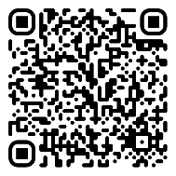
Key Dates & Resources
GMP DRI Website / www.gmpdri.com
NYS DRI Website /
www.ny.gov/programs/downtown-revitalization-initiative
Open Call for Projects / June 13 – August 08, 2025
Info Session and Office Hours / July 09, 10, 15, 22, 2025
Email Us / gmpdri2025@gmail.com

Slide 22
Agenda
1.
2.
3.
4.
5.
Welcome and Introduction
Overview of the DRI Process
Open Call for Projects
Open House and Public Workshop
Next Steps
Open House and Public Workshop
Vision and Goals
Overview of Workshop Activities

Slide 23
Engagement Timeline
LPC #1
May 13
Tuesday
LPC #2
June 10
Tuesday
LPC #3
July 29
Tuesday
LPC #4
Sept 9
Tuesday
LPC #5
Oct 7
Tuesday
LPC #6
Oct 28
Tuesday
MAY
JUNE
JULY
AUGUST
SEPTEMBER
OCTOBER
Public Survey
Fair at the Square : June 14
Loreto Park Concert : Late June / Early July
Tabling
Events 1 and 2
Tuesday, June 3
Morris Park Ave and Westchester Square BID
Public Workshop #1
June 10
Residence Inn
Public Workshop #2
Sept 2025
TBD

Slide 24
Timeline
Stakeholder Interviews
Are we missing any stakeholders?
Completed
In Progress
Community Board
Community Board 11
Business Improvement Districts (BIDs)
Morris Park Ave. BID
Westchester
Square BID
Neighborhood and Resident Association
Pelham Parkway Neighborhood Association
City Agencies
NYC Department of City Planning
Community Board
Community Board 10*
Business Improvement Districts (BIDs)
White Plains Road BID
Merchants & Developments Org.
Neighborhood Initiatives Development Corporation (NIDC)
Yemeni American Merchants Association (YAMA)
Alliance of Yemeni American Businesses (AYAB)
Neighborhood and Resident Association
Van Nest Neighborhood Alliance*
Indian Village Association
B-PECA (Bronx Park East Community Association)
Economic Development
Bronx Economic Development Corporation (BxEDC)
Local Health & Medical Institutions & Org.
Bronx House
R.A.I.N. Total Care, Inc.*
Medical Mile
Montefiore Medical Center
Albert Einstein College of Medicine
Jacobi Medical Center
Calvary Hospital
Bronx Psychiatric Center
Hutchinson Metro Center
Simone Development Corporation
Tourism & Community Engagement
Bronx Council for the Arts*
NYPL Library Branches
City Agencies
NYC Department of Transportation*
NYC Department of Parks and Recreation
NYC Economic Development Corporation
MTA NYC Transit
Notes:
* scheduled interviews
Notes:
Note which one is completed and in progress. According to the categories of the stakeholders by Gautam Orange stakeholders are done

Slide 25
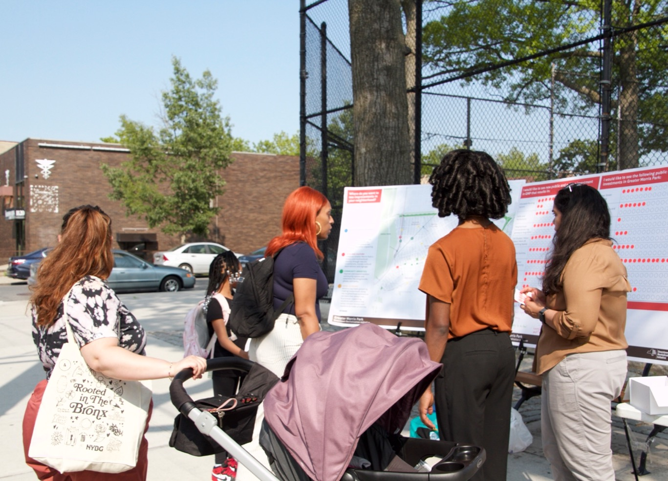
Tabling Events
Tuesday, June 3rd, 2025,
Westchester Square BID
1 PM - 3 PM
Loreto Park
4 PM – 6 PM
Total visitors
~70 people
Provided direct engagement with local residents, workers, shoppers, business owners, children, and youth.
Info: DRI goals and process, and open call for projects.
Feedback: Desires and Challenges
Notes:
Present the following as part of next slide
Initial Findings:
Participants would like to see the following outcomes from DRI investment: Affordable Housing Options, Playgrounds / Public Spaces, New Recreation and / or Community Spaces
Capital investments: Security Cameras, Open Space Improvements, Better Street Lighting, More Greenery / Street Trees

Slide 26
Recurring Themes (Desires and Concerns)
Safe and inviting pedestrian environments.
Cafés, restaurants, and public places with seating areas.
More and better outdoor spaces + recreation amenities, especially for teens to keep them better engaged after school.
Affordable housing
Drug store
More opportunities for public art.
Childcare facilities
Fragmented connections to and from key nodes, transit, and local destinations.
Poorly maintained and outdated open spaces and playgrounds.
Fast-moving traffic with unsafe conditions for bicyclists and pedestrians.
Missing “third spaces”

Slide 27
How are Vision and Goals Formed?
DOWNTOWN
ASSESSMENT
Existing and Planned Investment
Physical Conditions
Socio-economic Conditions
PUBLIC
INPUT
Initial Application
LPC and Public Input
Stakeholder Interviews
Vision, Goals, and Strategies

Slide 28
DRI Vision, Goals, and Strategies
Vision
Describes desired future conditions and quality of life for future generations.
Reflects shared community desires, takes into account community input, and is representative of the entire DRI area.
LPC reviews initial community vision and makes modifications to best reflect the unique characteristics of the DRI area.
Goals
Established to achieve the community’s vision for downtown revitalization.
Goals are detailed, attainable, and action-oriented with measurable strategies to guide the implementation of the DRI vision.
Strategies
Includes specific actionable items and metrics for tracking project impact.

Slide 29
Draft GMP DRI Vision Statement
Greater Morris Park will continue to grow and evolve as a multicultural neighborhood with a rich history, thriving community, and eminent medical employment center serving the New York City region.
New and expanded open spaces, and streetscape improvements will better connect the neighborhood’s key destinations, public transit, and local commercial corridors.
Support for local businesses and investment in public art will ensure a resilient, beautiful, and thriving community that celebrates its past while welcoming new neighbors.

Slide 30
Draft DRI Goals
1
Pedestrian Environment
Arts and Culture
Community Amenities
Local Economy
Hutch Metro Center Connectivity
2
3
4
5

Slide 31
Workshop Boards and Activities
1. Review the DRI process
2. Envision GMP
3. Build Shared Knowledge
4. Map Priority Locations
5. Learn About Next Steps

Slide 32
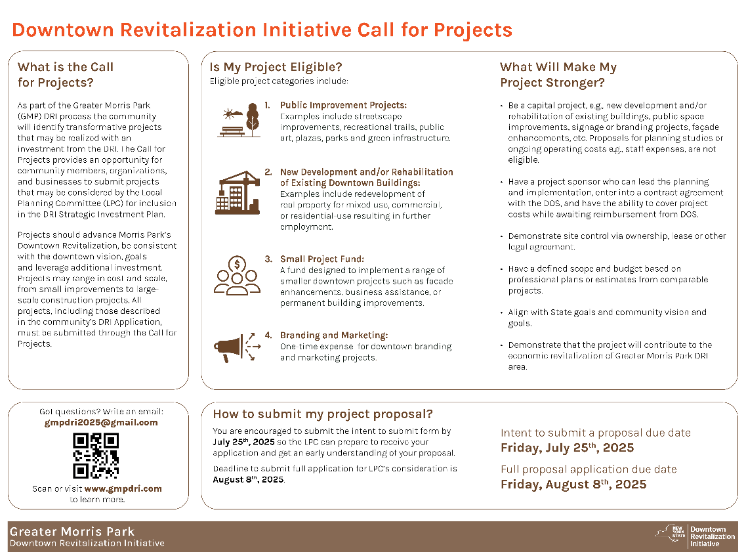
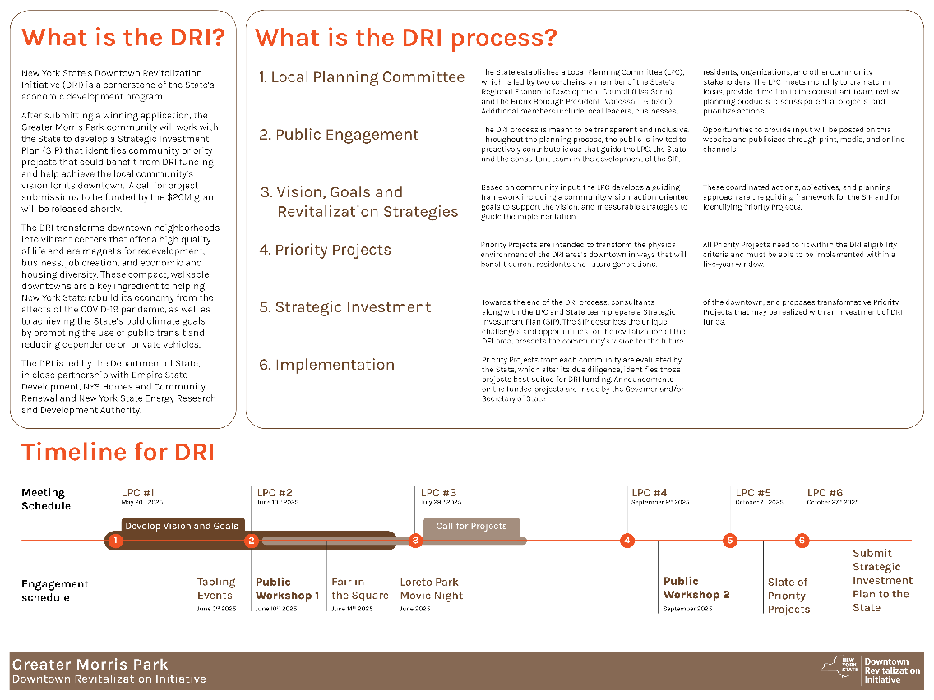
Overview
Review the DRI Process and Open Call for Projects

Slide 33
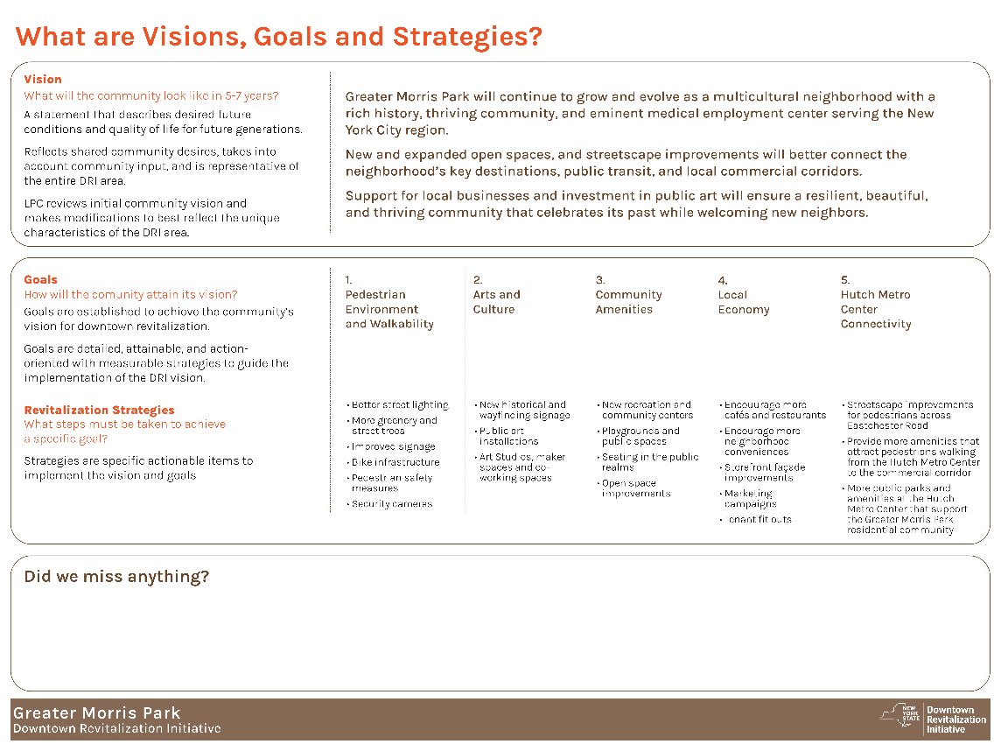

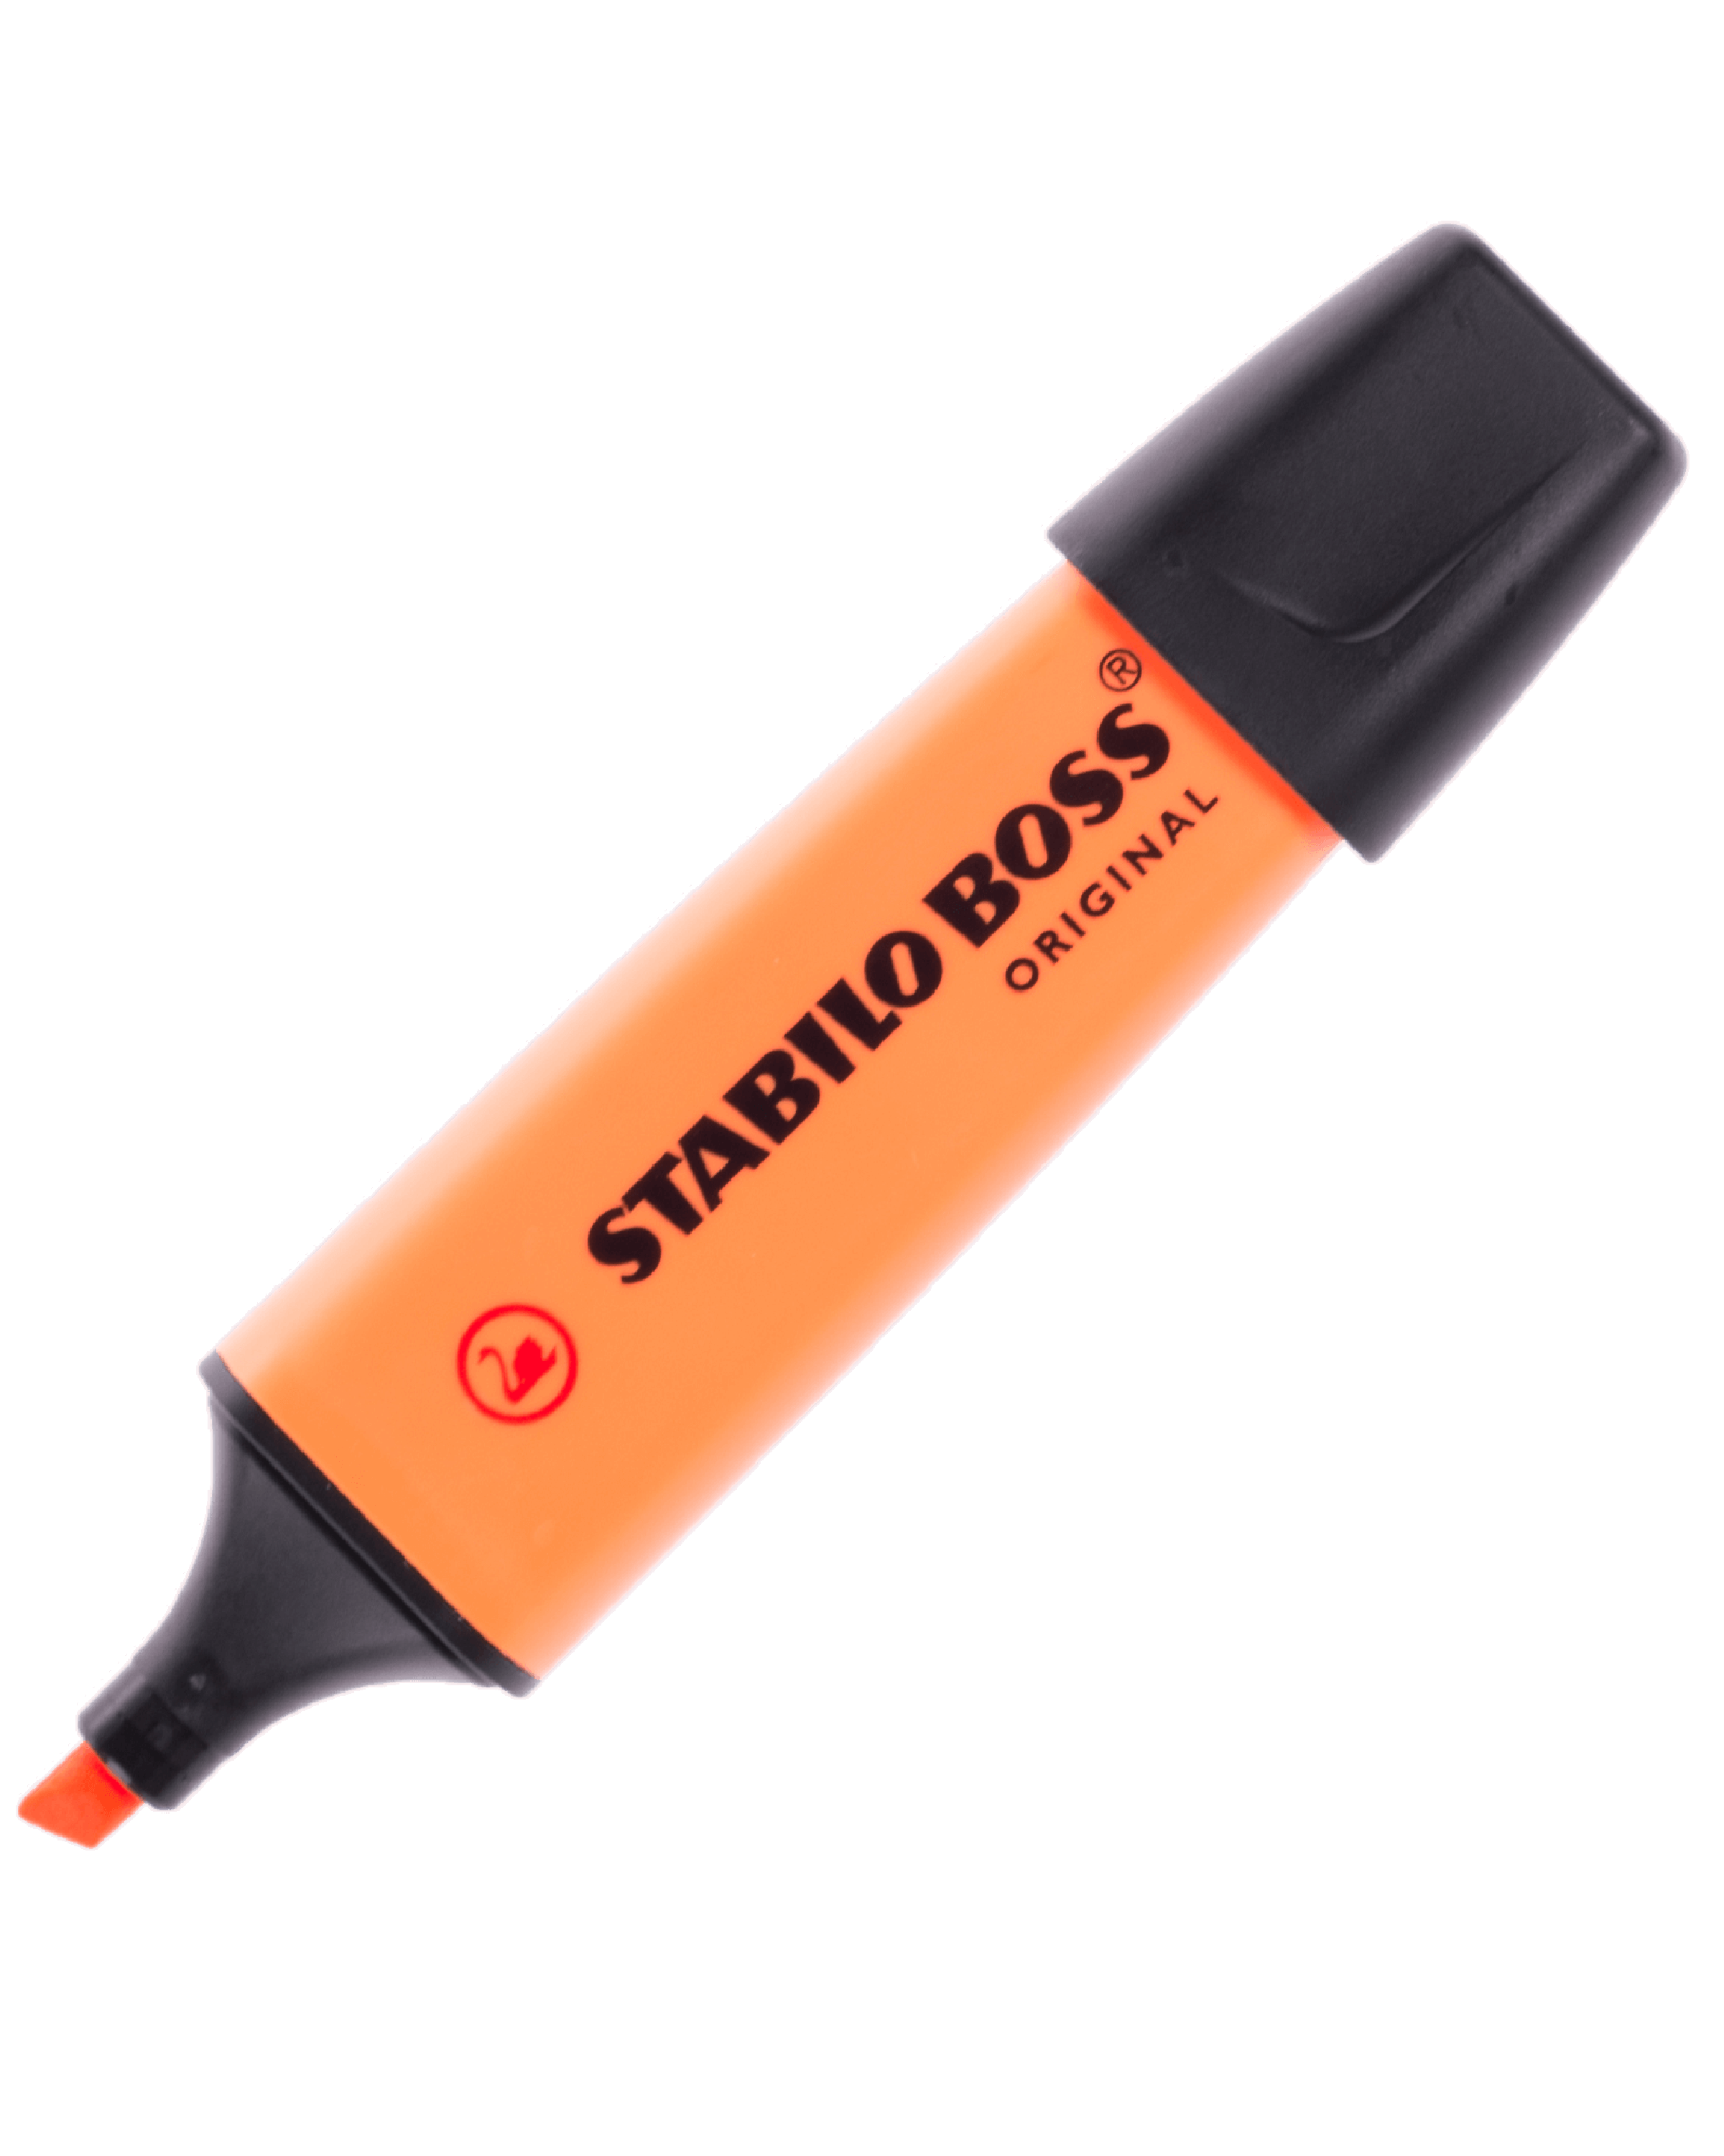

Visioning Activity
What will the community look like in 5-7 years?
How will the community attain its vision?
What steps must be taken to achieve a specific goal?

Slide 34

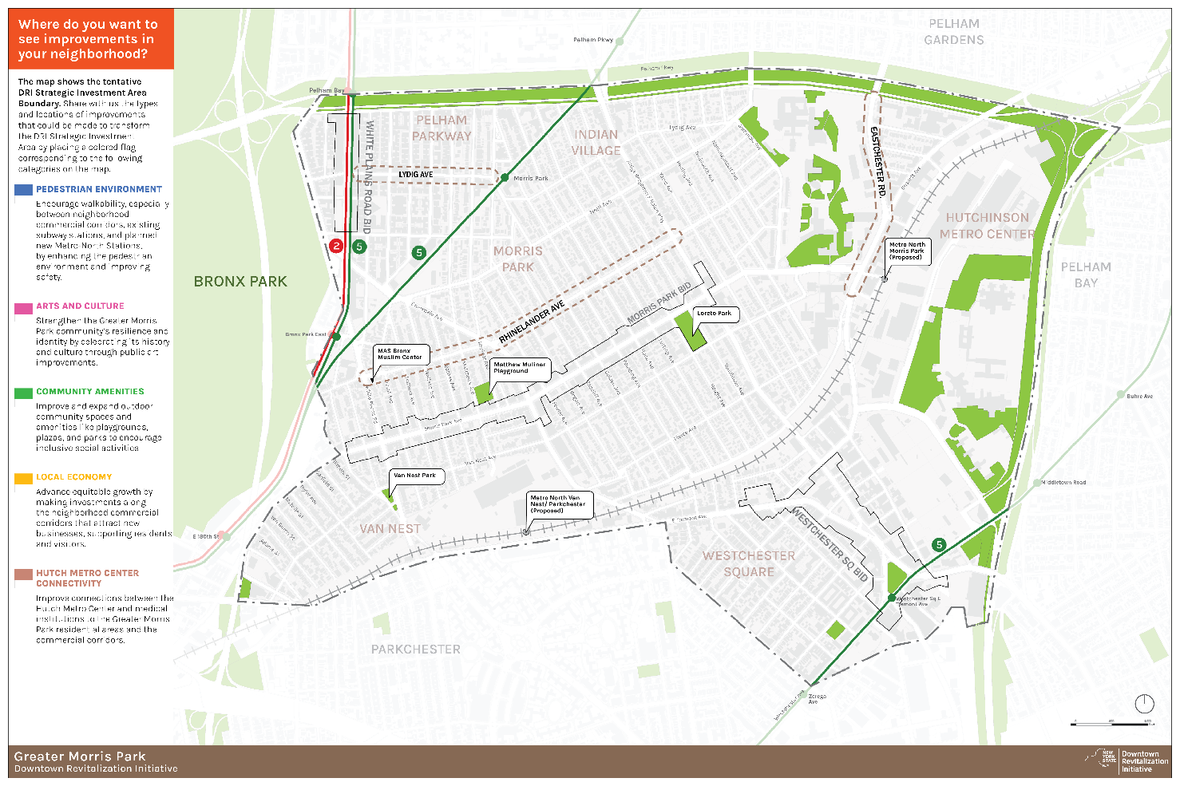




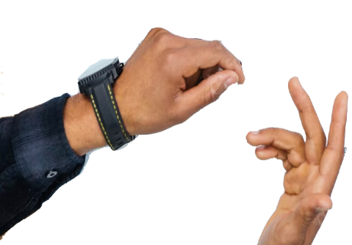
Mapping Activity
Identify types and locations of capital improvements that align with your priorities and could transform / revitalize the Greater Morris Park.

Slide 35
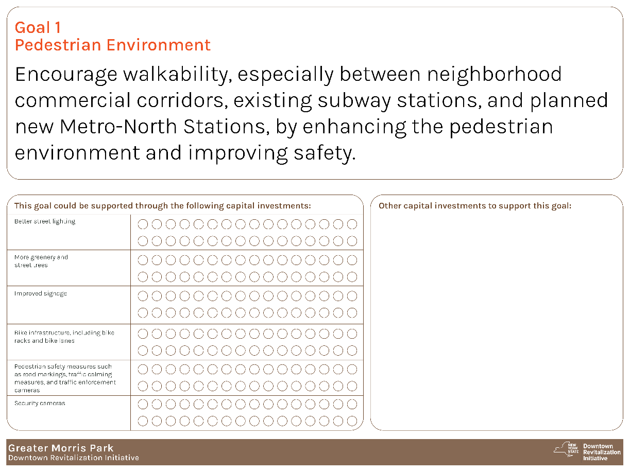



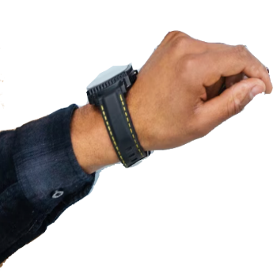
GMP DRI Vision & Goals
Share your ideas and thoughts on how each goal can be supported through various capital investments in the GMP DRI Investment Area.

Slide 36
Agenda
1.
2.
3.
4.
5.
Welcome and Introduction
Overview of the DRI Process
Open Call for Projects
Open House and Public Workshop
Next Steps
Next Steps

Slide 37
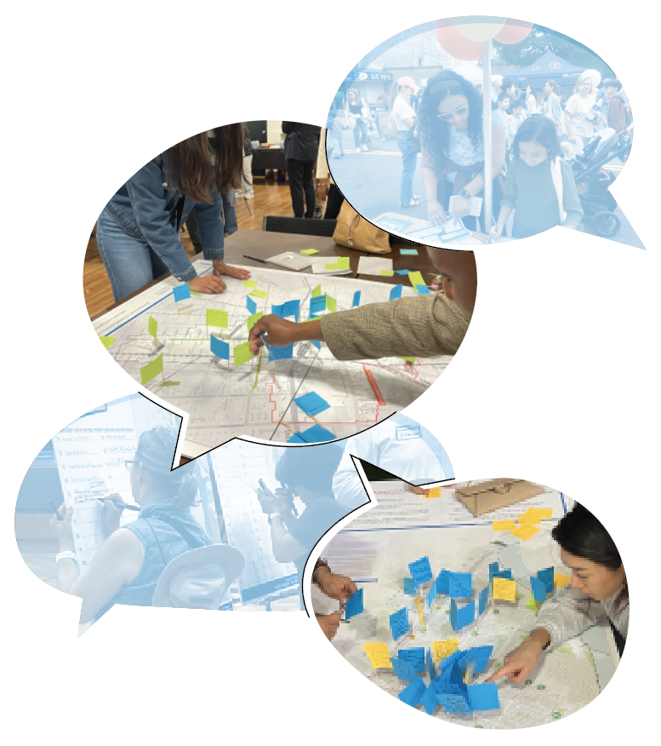
Next Steps
Open Call for Projects
Intent to submit : July 25, 2025
Project form : August 8, 2025
Next LPC Meeting
July 29, 2025
Location TBD
Next Public Workshop
September 2025

Slide 38
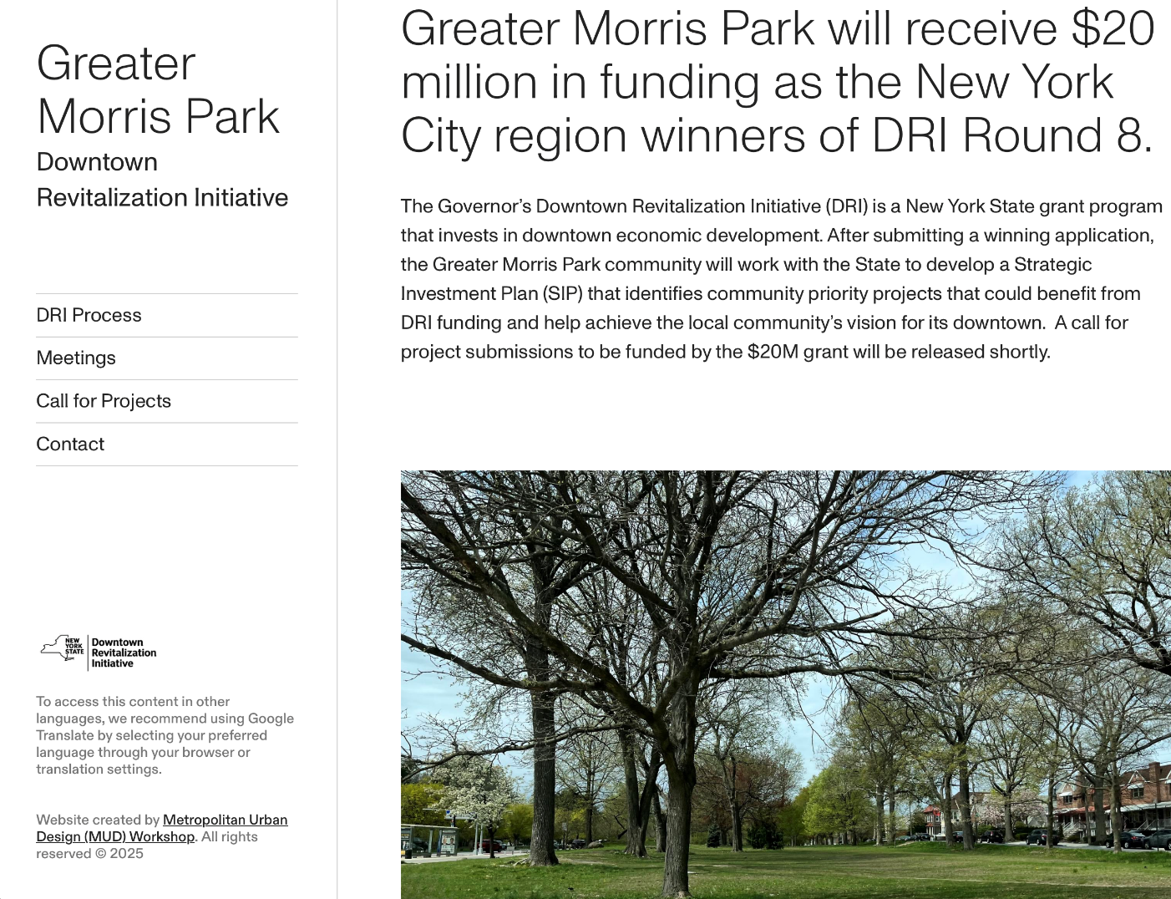
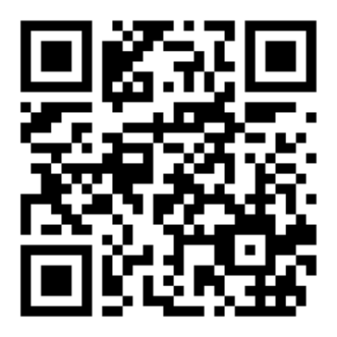
Thank You!
Take the survey:
Visit:
www.gmpdri.com for more information
Contact us at: gmpdri2025@gmail.com

