Slide 1
‘Faith in Funerals’: religion and spirituality in ‘secular’ funerals
Project team:
Dr Naomi Thompson
Prof Chris Baker
Steve Cheal
Meghan Spacey
Notes:
Project funder
Mention all methods
What will cover today
Analysis is ongoing of this data

Slide 2
Aim of session
The purpose of this session is to introduce some of the research findings from the Faith in Funerals project and relate them to how a funeral arranger can better support families when they are arranging funerals services for their loved ones

Slide 3
Learning Outcomes
By the end of this session, arrangers will be better able to:
Understand better the spiritual and religious needs of people arranging funerals for their loved ones.
Reflect on how to cater for a range of spiritual needs and viewpoints.
Explain to people the nuanced ranges of options in relation to spiritual and religious content.
Guide people to make choices that meet their spiritual and religious needs.
Understand the influence they have when people are making these decisions.
Consider differences between a religious minister and a celebrant.

Slide 4
Ice Breaker
Introduce yourselves and mention, in a few words, your spiritual / religious perspective
Choose a song that you think is in the top 25 songs
chosen at funeral services

Slide 5
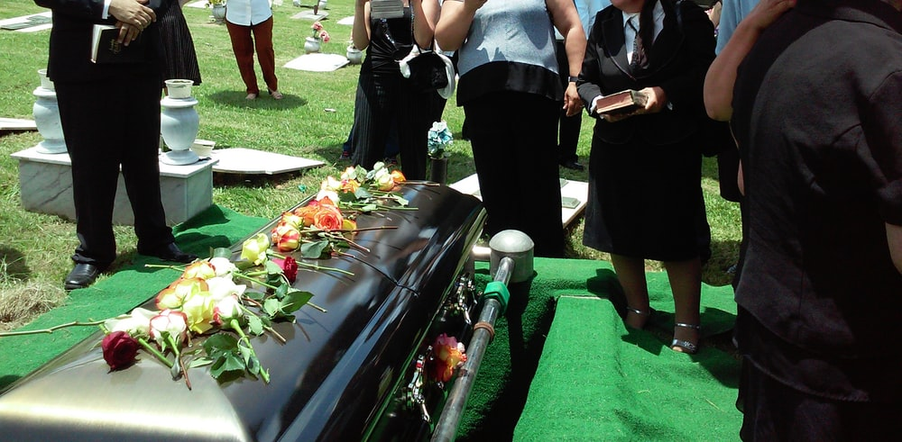
Project Background
Despite no legal requirement to do so, almost everyone has a funeral.
In 2002, registrars in the UK led the first civil funeral ceremonies. Whilst considered secular, the first of these services included the Lord’s Prayer.
Since then, there has been a sharp rise in the number of independent celebrants with the majority of funerals now conducted by these celebrants.
There is no common understanding as to what constitutes a civil ceremony, particularly as there are aspects of religion within such services.
Whilst research exists into some alternative, non-religious funerals, these have tended to focus on particular examples, such as woodland burials, Humanist services, and home funerals. Everyday civil funerals have received little attention.

Slide 6
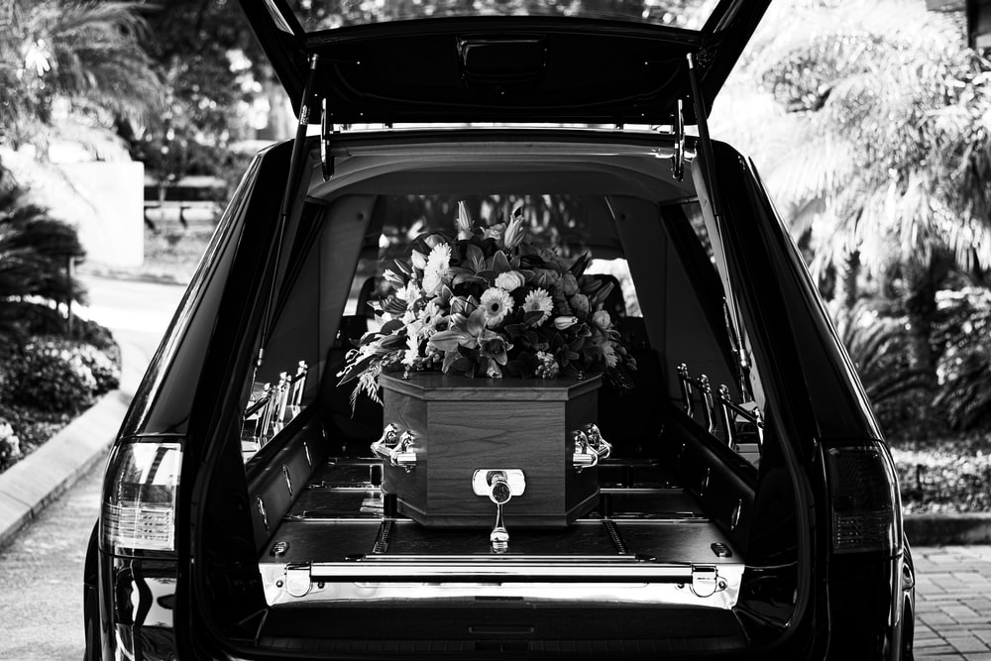
Research aims
1. To explore how the growing use of independent funeral celebrants represents change to the way funeral ceremonies are created and enacted in the current UK context, particularly in relation to the fusion of religious and non-religious content.
2. To offer nuance and challenge to statistics and debate around secularization.
3. To open dialogue about religious/secular divides in relation to funeral practices specifically, and to understand how the fusion of various religious and non-religious resources in funerals challenges such divides.
4. To explore to what extent everyday funeral practices in England might be analysed and understood through the theoretical lenses of ‘lived religion’ and/or ‘non-religion’.

Slide 7
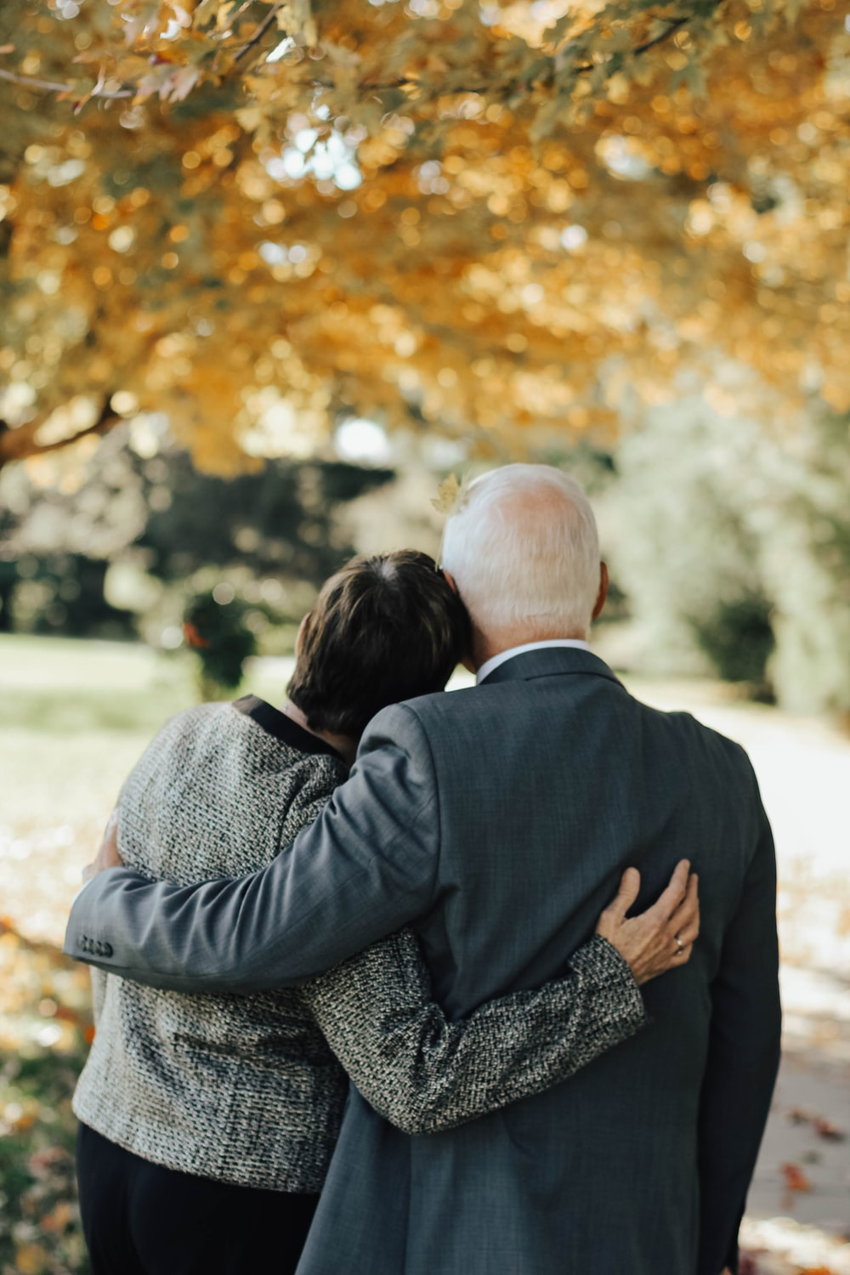
Research activities
A content analysis of 1000 funerals conducted by independent celebrants in England and Wales.
A national survey to funeral directors/arrangers.
Interviews with family members involved in arranging funerals for a loved.
Interviews/focus groups with independent celebrants.
Interviews/focus groups with funeral directors.
Interviews with Christian ministers.

Slide 8
Who were the funerals for?
Age: 1.3% were 100+ years old
18.3% were 90-99; 31.6% were 80-89;
22.6% were 70-79; 13.2% were 60-69;
7.6% were 50-59; 3% were 40-49;
1.3% were 30-39; 0.5% were 18-29;
0.6% were under 18
Gender: 48.3% were female, 51.7% were male.
Notes:
Diversity of the celebrants – 2 white males, 3 white females, 2 black females
Celebrants were from England and Wales
The celebrants did not keep consistent records of ethnic and religious backgrounds of the deceased and their families so we cannot analyse this.

Slide 9
Religious content
65% of services had the Lord’s Prayer
23% had other prayers
38% had at least one hymn
25% had a reading from scripture
In total 76% of services had one or more of a reading, hymn or prayer

Slide 10
Popular songs and poems
There is complexity over how we categorise popular music and poems, particularly where angels, heaven or afterlife are referenced.
Song examples:
Jesu’ joy of man’s desiring – instrumental piece
Ave Maria / Sung version of Lord’s Prayer
Eric Clapton – Tears in Heaven
Robbie Williams – Angels
Stairway to Heaven / Turn turn turn - etc

Slide 11
Popular poem examples
Gone from my sight – Henry Van Dyke
Do not stand at my grave and weep – Mary Elisabeth Frye
All is Well – Henry Scott Holland
The Ship - Bishop Brent
Look for me in Rainbows – Conn Bernard
God’s Garden - Melissa Shreve
She/he is gone – David Harkins

Slide 12
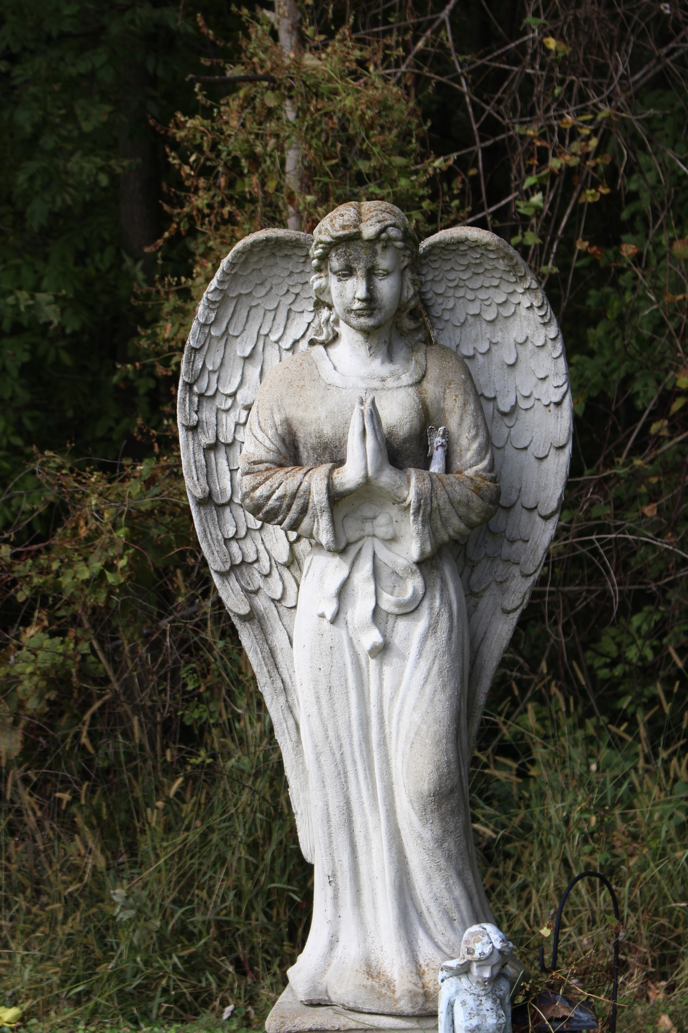
Rise in Celebrancy and matching officiants with families
One common message from the Arrangers was the huge rise in celebrant-led funerals over the last two decades and how these services have changed and how important it is to match a family with the right officiant.
One arranger said ‘Church services are on the decline, and celebrancy is on the up. There is a danger that the market it being saturated with celebrants’
‘Celebrant-led services tend to be much more person-centred, and not reliant on church-based liturgies’
‘My role is to establish what the family needs in their service to best suit them’

Slide 13
Religious or Non-Religious?
Our interviews established some common questions families are asked in this regard when choosing the right officiant.
Do you have someone you know who you would like to lead the service?
Would you like a religious or a non-religious service?
Would you like a religious minister or a celebrant? Would you like a male of a female?

Slide 14
Matching families with an officiant
Sometimes an officiant is more carefully ‘matched’ with a family, perhaps because an arranger has found a common interest between the two, such as a location or a hobby. Sometimes a celebrant is chosen because they can work closely with different types of families.
This method is challenged by some. One celebrant told us ‘I don’t know why some families are not considered for me to work with them. I have worked with all sorts of families over the years, and have received excellent feedback afterwards’

Slide 15
Activity – Matching officiants with families
1) What questions do you as an Arranger ask a family when they come in regarding the type of officiant they require?
2) What do you keep in mind when asking people which officiant would best suit the family?
3) Do you know celebrants who can work with many different families and tailor their approach according to the family?
4) What else would you like to establish before recommending an officiant?

Slide 16
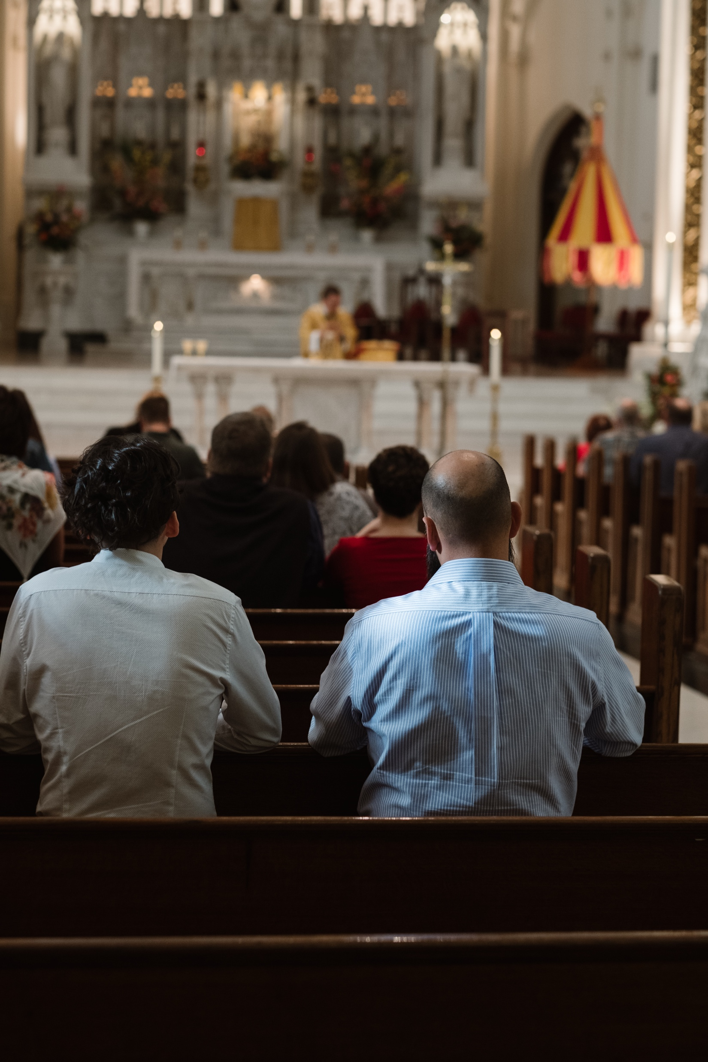
A religious funeral is…?
The choice between a ‘religious’ and a ‘non-religious’ service is not straight-forward. The arrangers we interviewed had different ideas about what constituted a religious service.
One arranger told us (and several others said similar) ‘Commonly, people ask for a non-religious service, but then say they’d like the Lord’s Prayer or a hymn’

Slide 17
A religious funeral is…?
Below are varied ideas from arrangers and celebrants about what they felt constituted a religious service.
'The inclusion of The Lord’s Prayer or anything religious’
‘A religious committal’
‘Having something like The Lord’s Prayer doesn’t make it religious, it just gives it a religious bias’
‘My services that include religious content aren’t religious, because I’m not religious. It’s the element of religious rites that makes a service religious’
‘I don’t invite people to join in with the Lord’s Prayer and I don’t believe in prayer. Therefore, it’s not religious, it’s just me reading words, as I would a poem’.

Slide 18
Activity
What do you think constitutes a religious service?
In which situations would you appoint a celebrant over a religious minister?

Slide 19
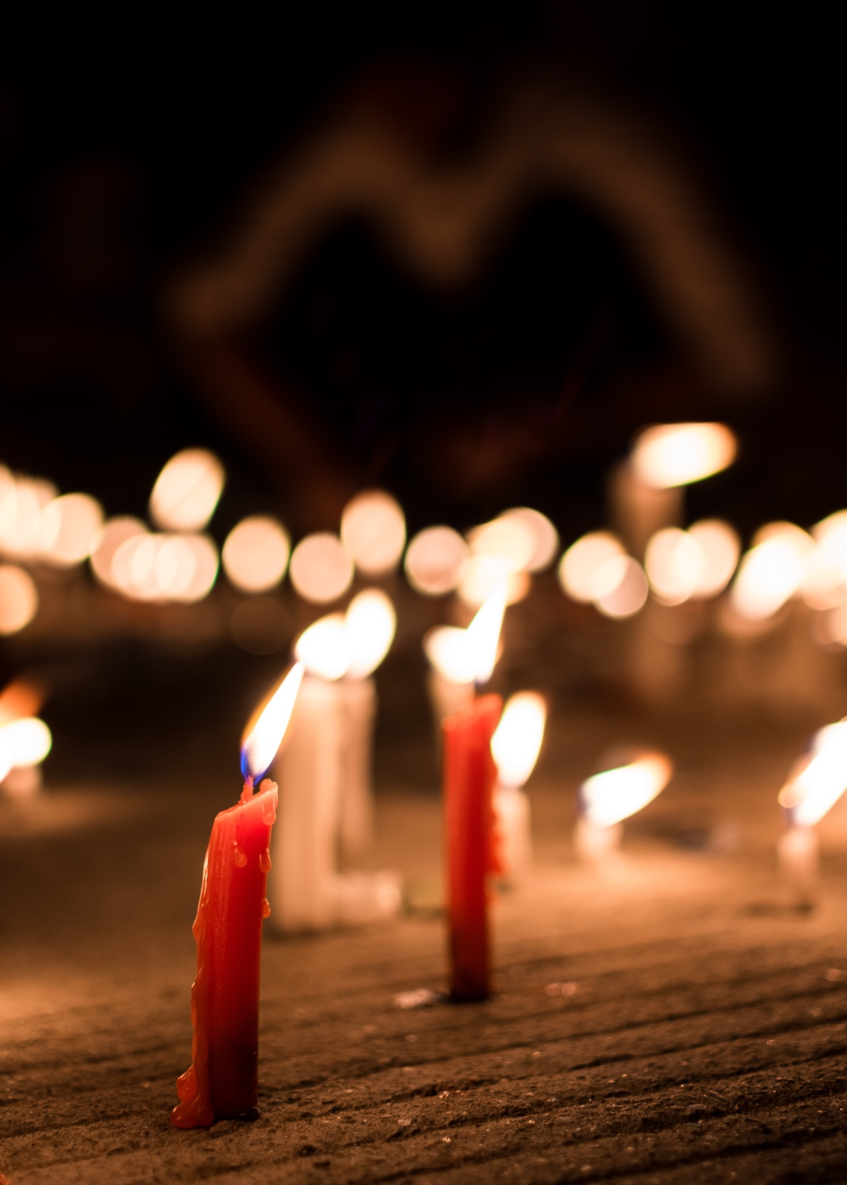
Guiding people around religious content…
Some celebrants actively ask if people would like religious content (such as the Lord’s prayer), some don’t mention it until the family do, some actively dissuade people.
‘I think a few years ago, a lot of people put in the Lord’s Prayer for Aunt Betty, because otherwise she doesn’t feel that it’s a real funeral’
‘People have the Lord’s Prayer to hedge their bets’
‘Some people feel that, without a hymn, it isn’t a proper service’

Slide 20
Location, Location, Location
This is important in terms of our research, as different places in the UK have a different relationship with its local church and parish. This might, for example, be very different in a small village / town to a big city.
One Arranger said ‘my town is a community area, because there are a lot of wealthy people who have time to put a lot of resources into the community. And a lot of people attend church, and the churches have a lot of events on’.
Another Arranger said that they arranged many funerals in correlation with one of the churches, as they had both a family historic link and / or a current friendly relationship with the family.

Slide 21
Activity
What role do local churches play in your community?
Does the role of the church in the community influence your thinking regarding asking a local religious minister to take a service for a family?

Slide 22
Pastoral Care
There is some debate about whether a religious minister or a celebrant offers better pastoral care, both during and post service.
Our research showed that some people think religious ministers bring things that celebrants can’t – or don’t – because they represent the Church. For example, the view that a religious minister offers better pastoral support than a celebrant can.

Slide 23
Pastoral Care and Personalisation
There was not consensus about who offers better or more personal care.
One arranger said ‘It’s not my experience that religious ministers are better at pastoral care. It’s awful to say, but I think a vicar’s job is just a job now. I don’t think it used to be, but they’ve just got so much going on now’.
On the flip side, one arranger told us that ‘the Church still has a significant role in people’s thinking, whether they want a religious service or not’
Some arrangers interviewed told us that a celebrant’s service is usually more personal than a religious one, and that some celebrants spend more time with a family than a religious minister. Others felt that ministers had more long-term contact with people after a funeral.

Slide 24
Activity – Pastoral Care and Personalisation
How do you think celebrants and religious ministers differ in terms of the pastoral care they offer families?
How do you think religious ministers and celebrants differ in terms of the personalisation of a service?

Slide 25
Understanding your own spiritual / religious perspective to guide others
We all have our own personal belief systems, and in order for an arranger to be able to guide a family, we have to understand our starting point. Arrangers have different ways of guiding people.

Slide 26
Activity – Scenario 1
You’re meeting a family and they tell you that they’re not sure if they should include the Lord’s Prayer or a hymn in the service. Their 93-year-old Mum was Church of England affiliated, and went to Sunday school as a child, but wasn’t a regular churchgoer. She liked watching ‘Songs of Praise’ on a Sunday afternoon. The two grown up children organising the service have no interest in religion.
How do you guide them through the options and help them decide?
What factors are important here?
How does your own belief affect your guidance and influence the family?
Who would you suggest / recommend leads a service for this family?

Slide 27
Activity – Scenario 2
You’re meeting a father (in his mid-70s) who is arranging the funeral for his 48-year-old son. The father’s wife died three years ago, and his son leaves two teenage children, and has no current partner. The children aren’t coping well, so the father is dealing with arrangements.
He says that he has no faith, but his late wife was a church-goer and so her service included prayers, a bible reading and a couple of hymns. His son had no religious leanings at all, and nor do his children.
He then says that if his wife was here, she would be adamant that there should be some religious content. He doesn’t like God at the moment but is very much torn because he also wants to respect his late-wife’s beliefs.
How do you guide them through the options and help them decide?
What factors are important here?
How does your own belief affect your guidance and influence the family?
Who would you suggest / recommend leads a service for this family?

Slide 28
Activity – Scenario 3
You meet with the large family of a 60-year-old man who has died. He loved football and rugby and would belt out ‘Abide with me’ on FA Cup final day and ‘Jerusalem’ at England rugby matches. But, at the same time, he would have described himself as an atheist. He has one sports-mad daughter in her 30s and one son who hates sports.
His wife is very passive and just wants everyone to be happy. His uncle, however, is a retired vicar, and although he doesn’t want to take the service, he is very much pushing for it to be a religious service. He’s becoming quite animated. There appears to be some conflict in the room about this aspect of the service.
How do you guide them through the options and help them decide?
What factors are important here?
How does your own belief affect your guidance and influence the family?
Who would you suggest / recommend leads a service for this family?

Slide 29
Religious / spiritual beliefs are personal for each of us.
Hackney Marshes vs Church!
Here’s an example of how one family worked through their Mum and Dad’s services (who died within a short time of each other - Dad first, then Mum) with different religious viewpoints within the family…
‘The Hackney Marshes were my Dad’s church. He was a big Arsenal fan, but every Sunday was at the Marshes. Mum did church, and so wanted a hymn, a prayer and the Lord’s prayer. She was adamant.
So, we compromised and had Abide with me. Dad would have liked that as it’s sung at Wembley every year, and Arsenal have won more FA Cups than everyone else.
At Mum’s service, we had much more of a proper religious feeling as that was more for her. But not too much, because we’re (us kids) are not really into it!’

Slide 30
Family interviews – One person interviewed had organized 5 funerals in 4 years and had a range of officiants.
Her Dad’s service was led by a family-friend minister. This was a personal service, but she had no choice of readings.
Her Nan’s was led by an unknown minister, and she described this as one of the most impersonal / worst experiences of her life. ‘I’ll remember that for the rest of my life, but not for any good reason’
She arranged one for a good friend, led by a celebrant. She described this service as being personal but far too scripted.
She then arranged her Mother and Father-in-laws’ services. For these, the family had another celebrant, who she described as ‘less-scripted’, and ‘personal, warm and perfect’

Slide 31
Family interviews – a few quotes from our family interviews about their celebrant experience
‘We chose our celebrant carefully as we wanted someone who would go out of their way to make the service personal, interesting and – at times – happy, during a sad occasion. And they did’
‘We chose someone who was comfortable with the religious parts of the service – Psalm 23 / Morning has broken / The Lord’s Prayer, and we didn’t feel that that made it too religious’
‘The celebrant was organised, helpful and thoroughly professional. We couldn’t have asked for a better send-off’
‘We felt like the celebrant really cared about us’

Slide 32
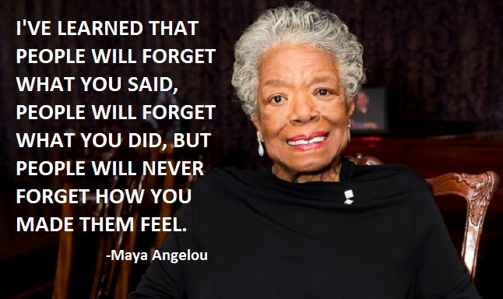

Slide 33
Has Covid had an impact?
Before Covid: 69% of funeral services had the Lord’s Prayer and 52% had a hymn (based on 166 services in late 2019/early 2020).
During Covid: 63% of funerals had the Lord’s Prayer and 43% had a hymn (based on 136 services in 2020/21).
Post Covid: 64% had the Lord’s Prayer and 34% had a hymn (based on 698 services in 2022).

Slide 34
Has Covid had an impact?
Much less hymn singing
‘The death of the organist’
The increased use of Zoom / Teams for remote meeting with families, especially those who lived a distance away from each other
The huge increased use of technology in services (Webcasting / Visual Tributes) etc.
A BIG increase in Direct Cremations
Crematoria are increasing their time slots for services, many from 40 /45 mins to 60 mins

Slide 35
Some final thoughts…
People can choose bespoke versions of almost anything for their service (e.g. coffins). But the key choice they have for an officiant is ‘Religious or non-religious?’, ‘male or female?’ Is this something which needs to change?
The arranger is, to a large extent, the gatekeeper to dealing with person who is asked to lead the service, and that person will have a significant effect on how that service is led.
Is there enough training for arrangers to understand the complexities and nuances of people’s spiritual and religious needs?

Slide 36
Questions
How do you see your role in identifying the spiritual and religious needs of people when they’re arranging the service of a loved one?
How do your own spiritual and religious beliefs influence how you guide others in that respect?
What can Arrangers do better to allow people’s spiritual and religious needs be fully reflected in their loved-one’s service?
How do training courses and CPD need to be developed / improved to help Arrangers deal with people’s spiritual and religious needs? What tools / resources might help them?

Slide 37
Thank you for listening.

